Slide 1
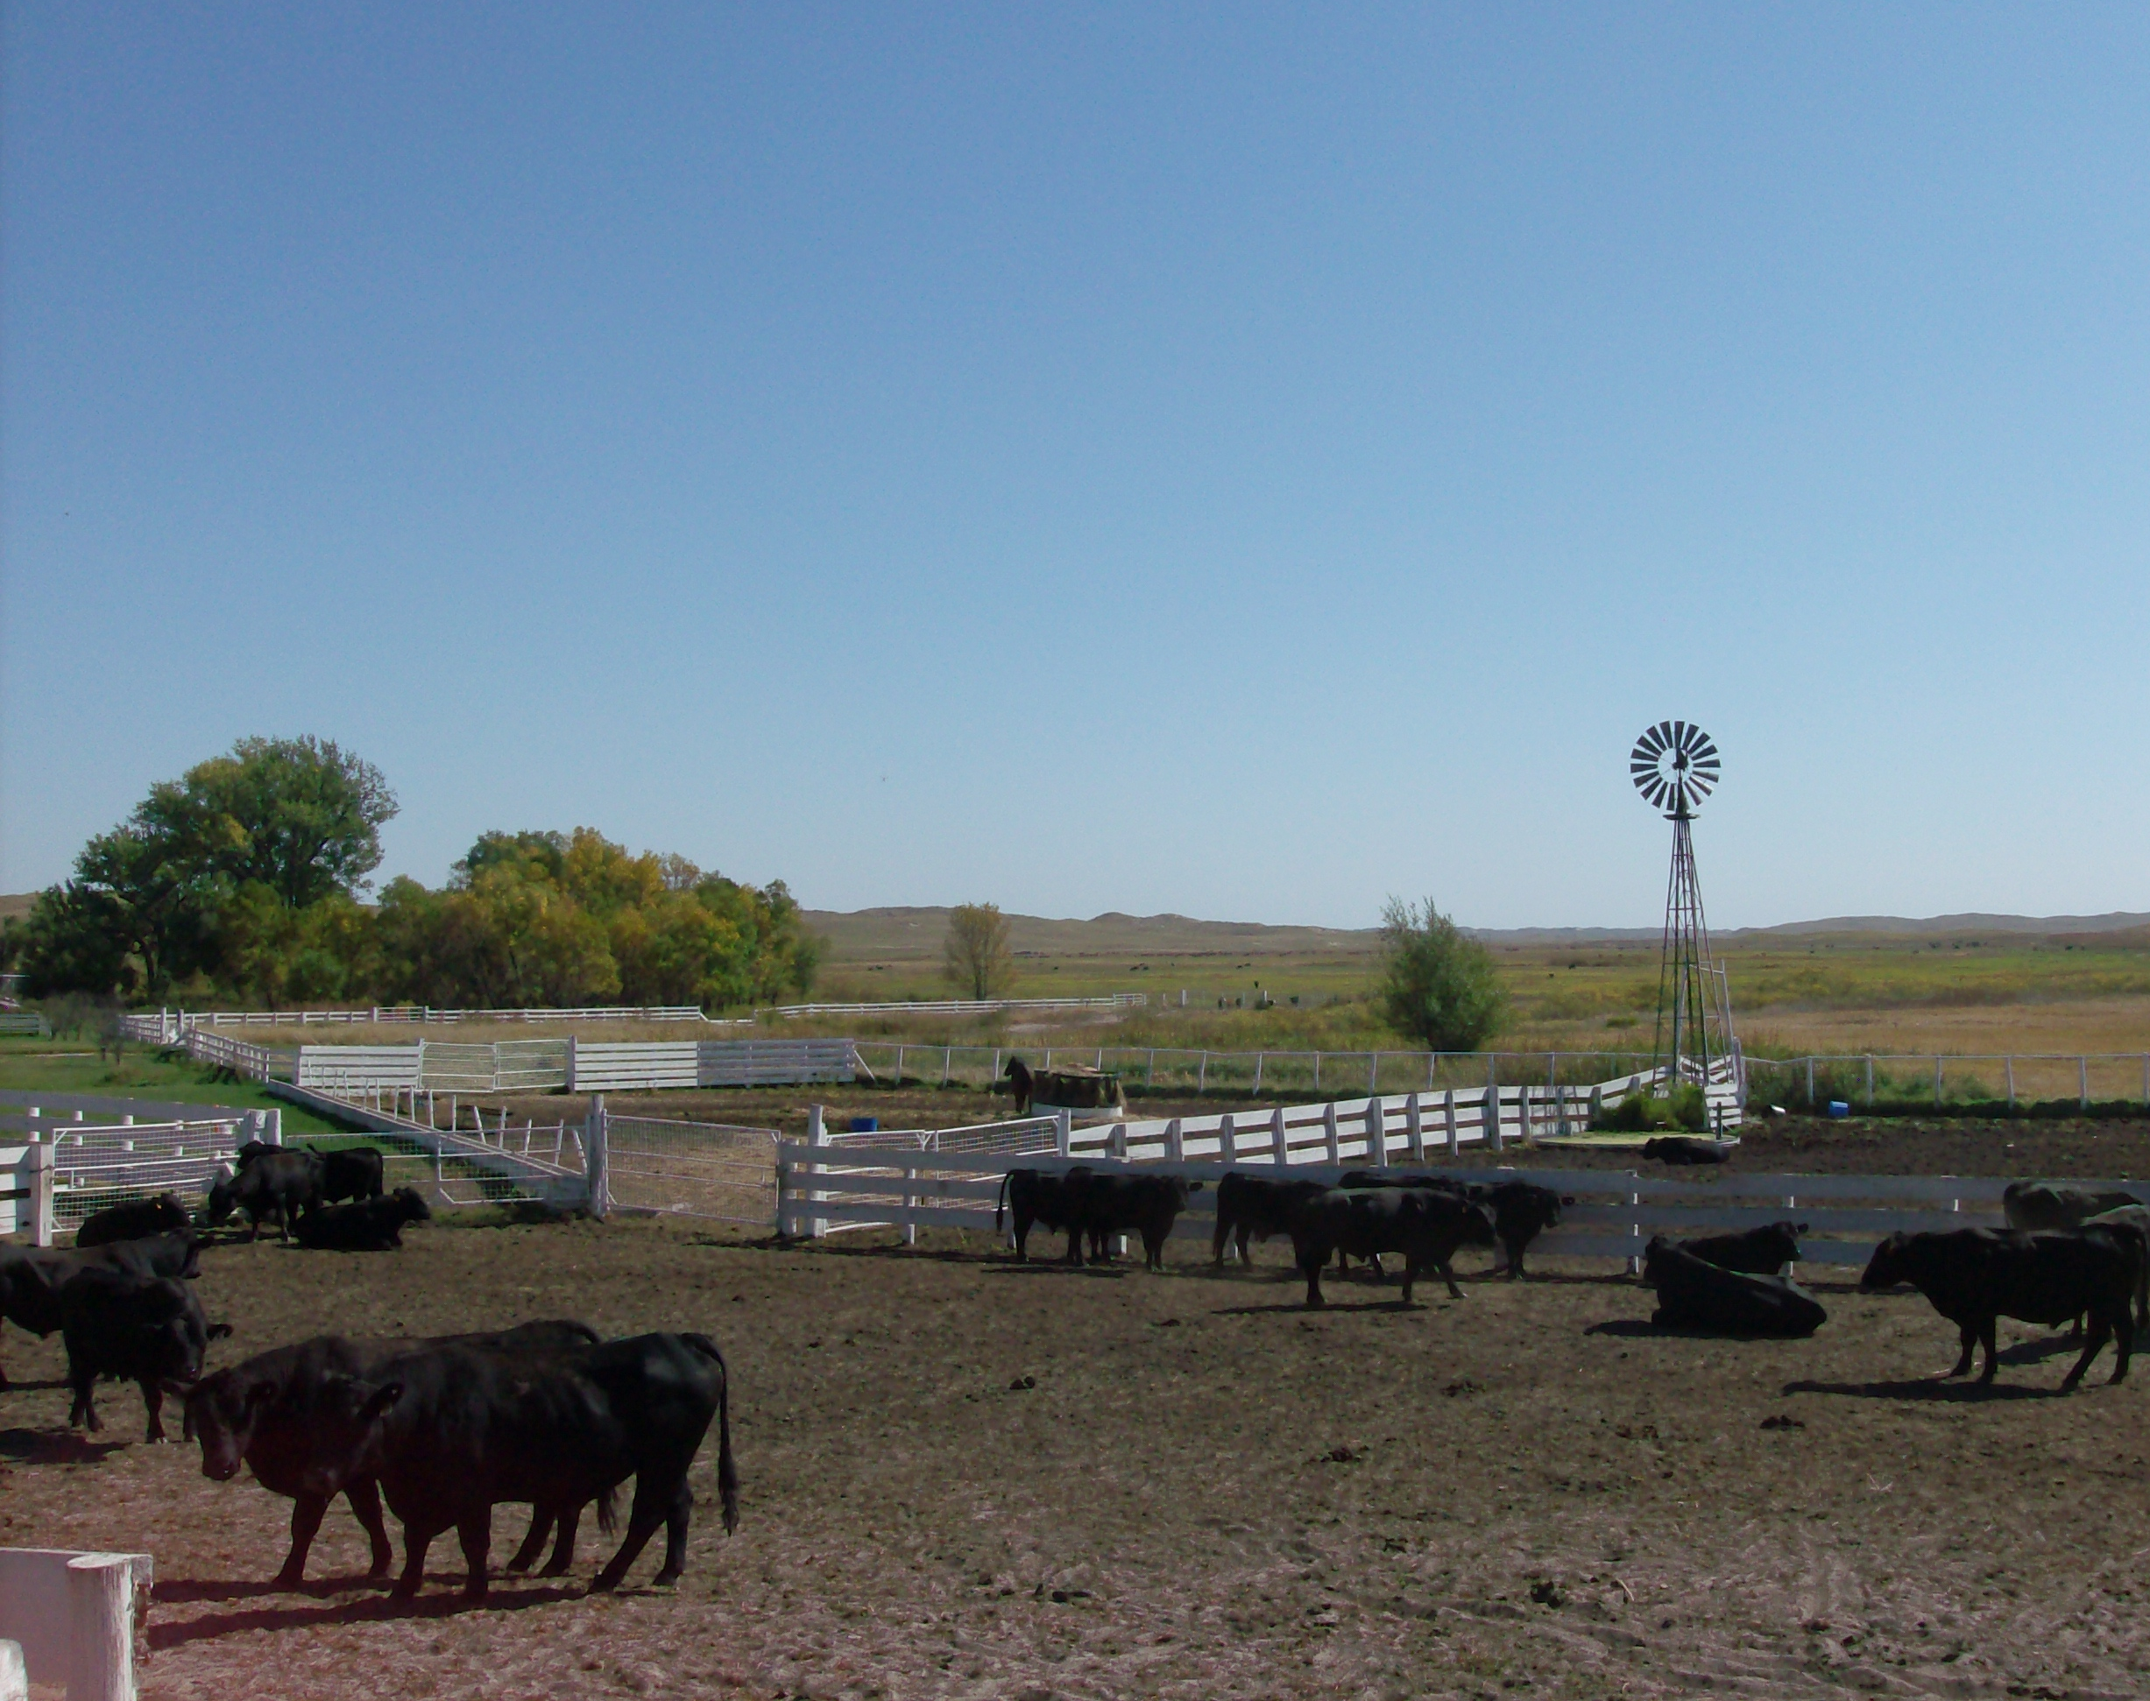
Bovine Trichomoniasis
Roger Dudley DVM
roger.Dudley@nebraska.gov
(402) 471-2351
Thanks to Dr Jeff Ondrak – USDA

Slide 2
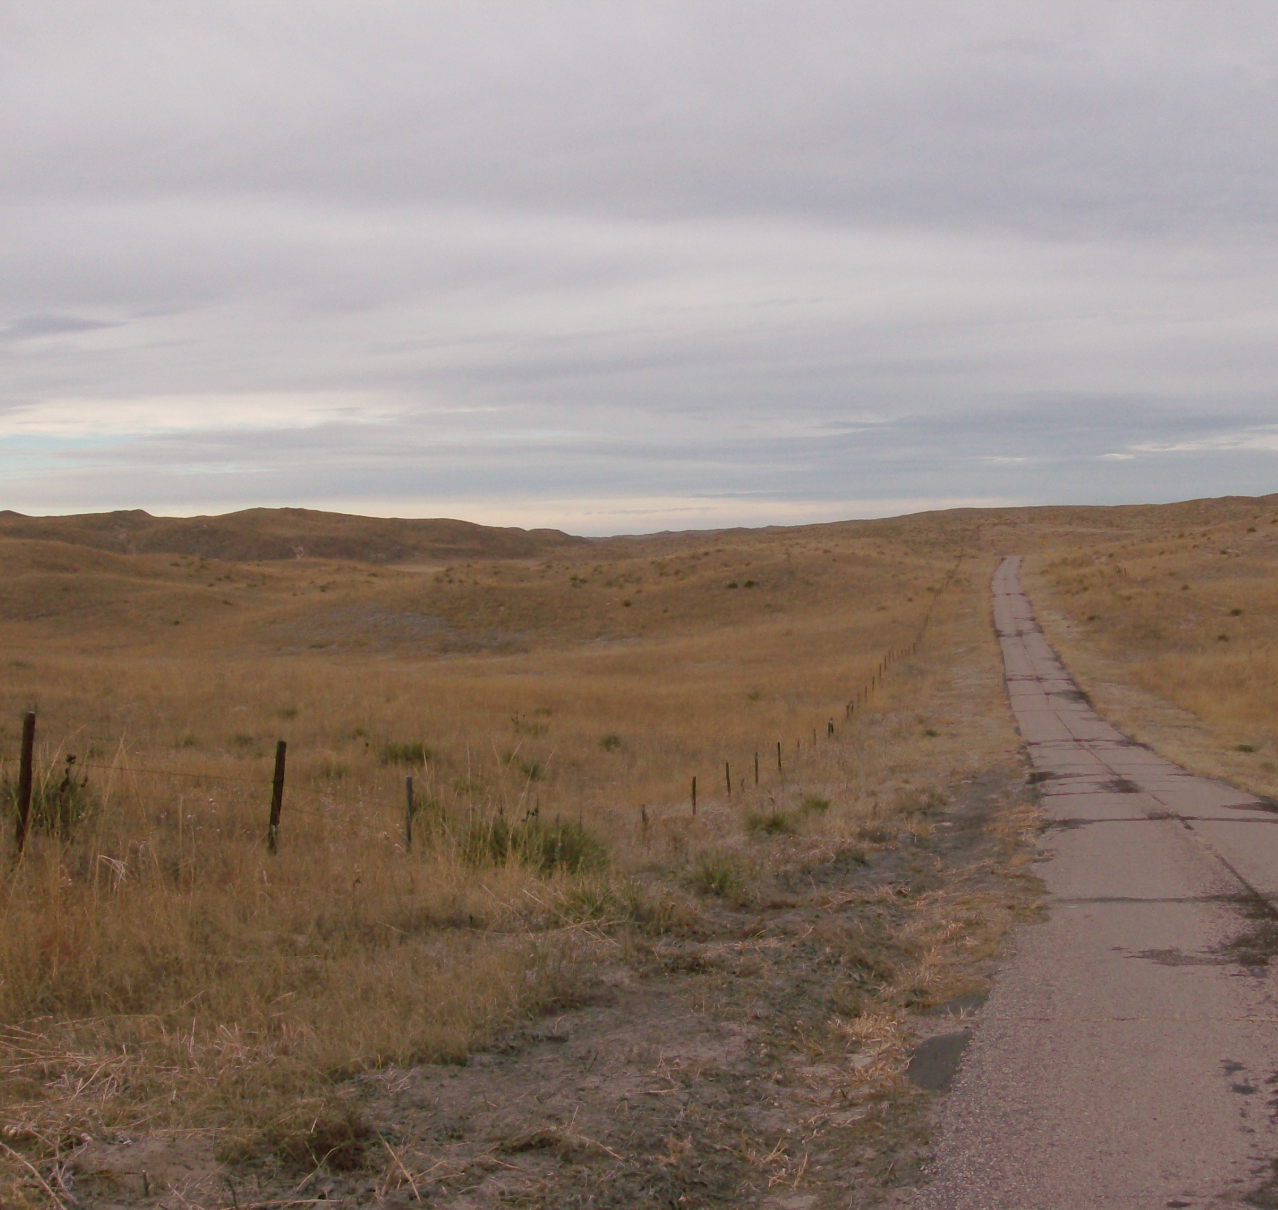
Objective
To provide a basic level introduction to Bovine Trichomoniasis
Understand the Trich disease reporting requirements in NE.

Slide 3
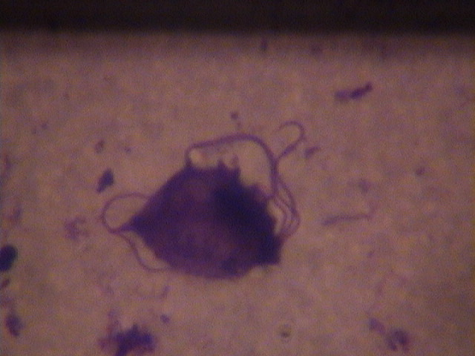
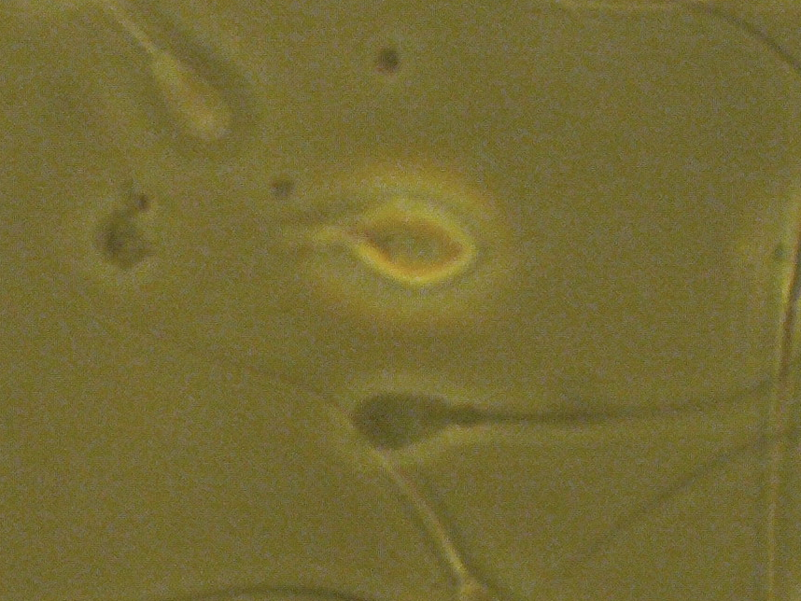
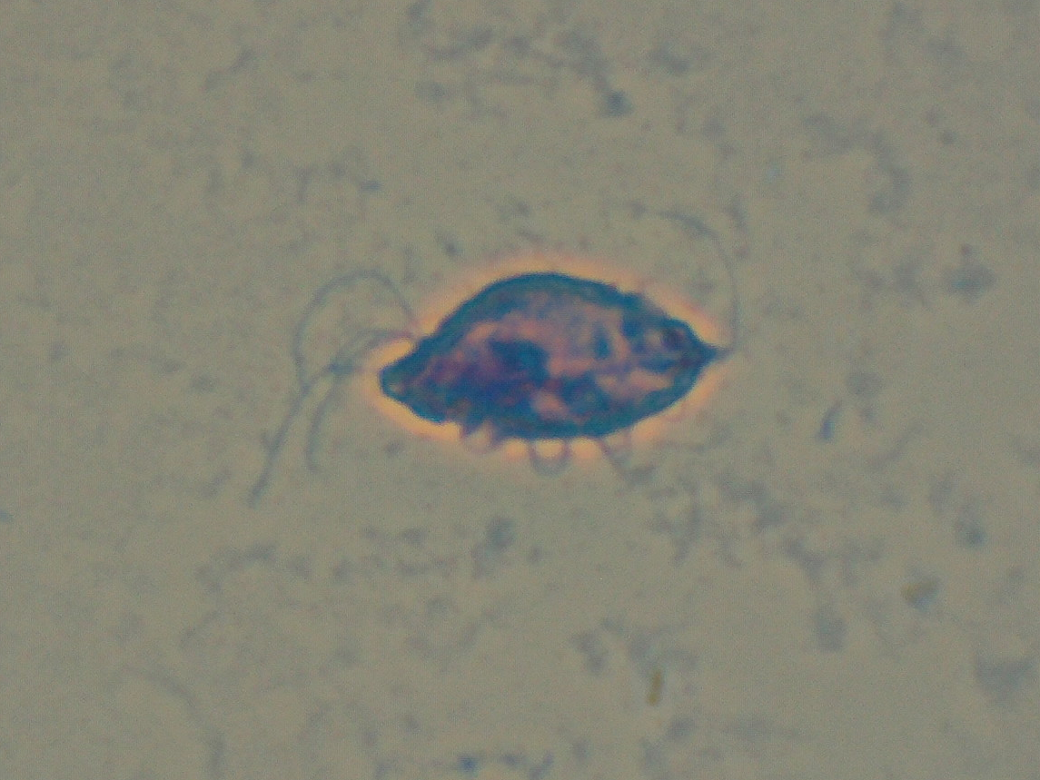
Tritrichomonas foetus
Tri = 3; trich = hair
10-25 µm x 5-10 µm
Obligate parasite of the bovine reproductive tract
Highly contagious venereal disease
No approved treatment
Notes:
Highly contagious - 80-90% of females infected from breeding to infected bull (95% for virgin heifers)

Slide 4

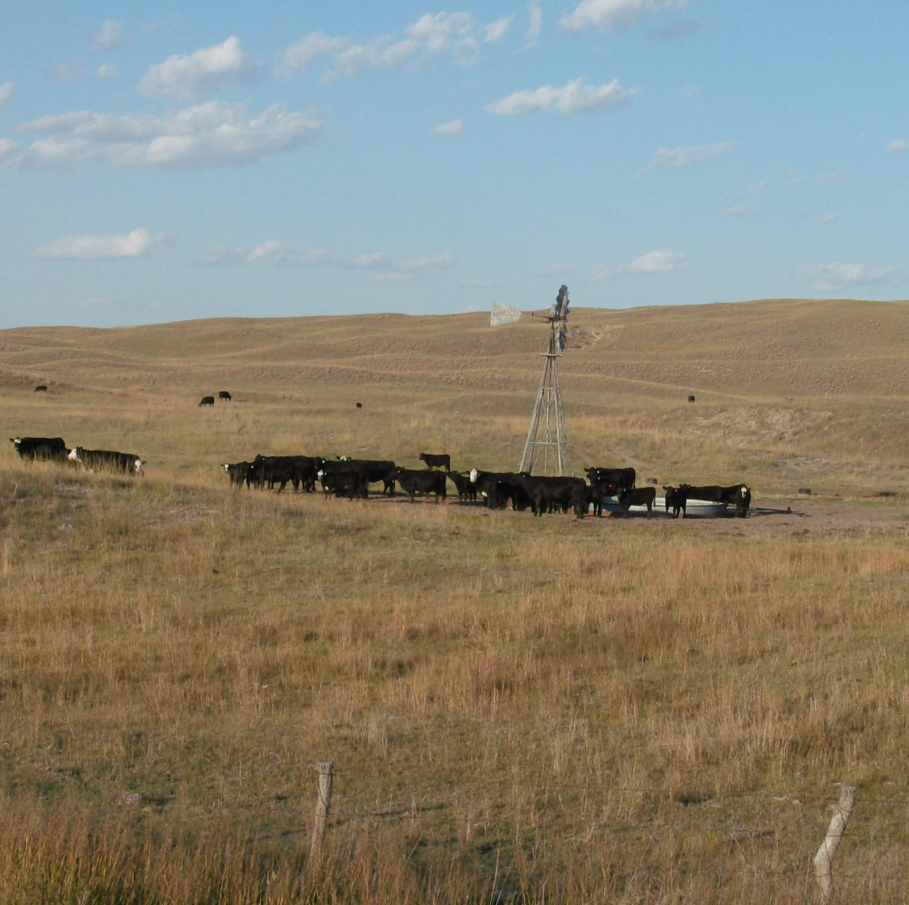
History
1888 France
1920’s World-wide
1932 Pennsylvania dairy
1958 Western U.S.

Slide 5
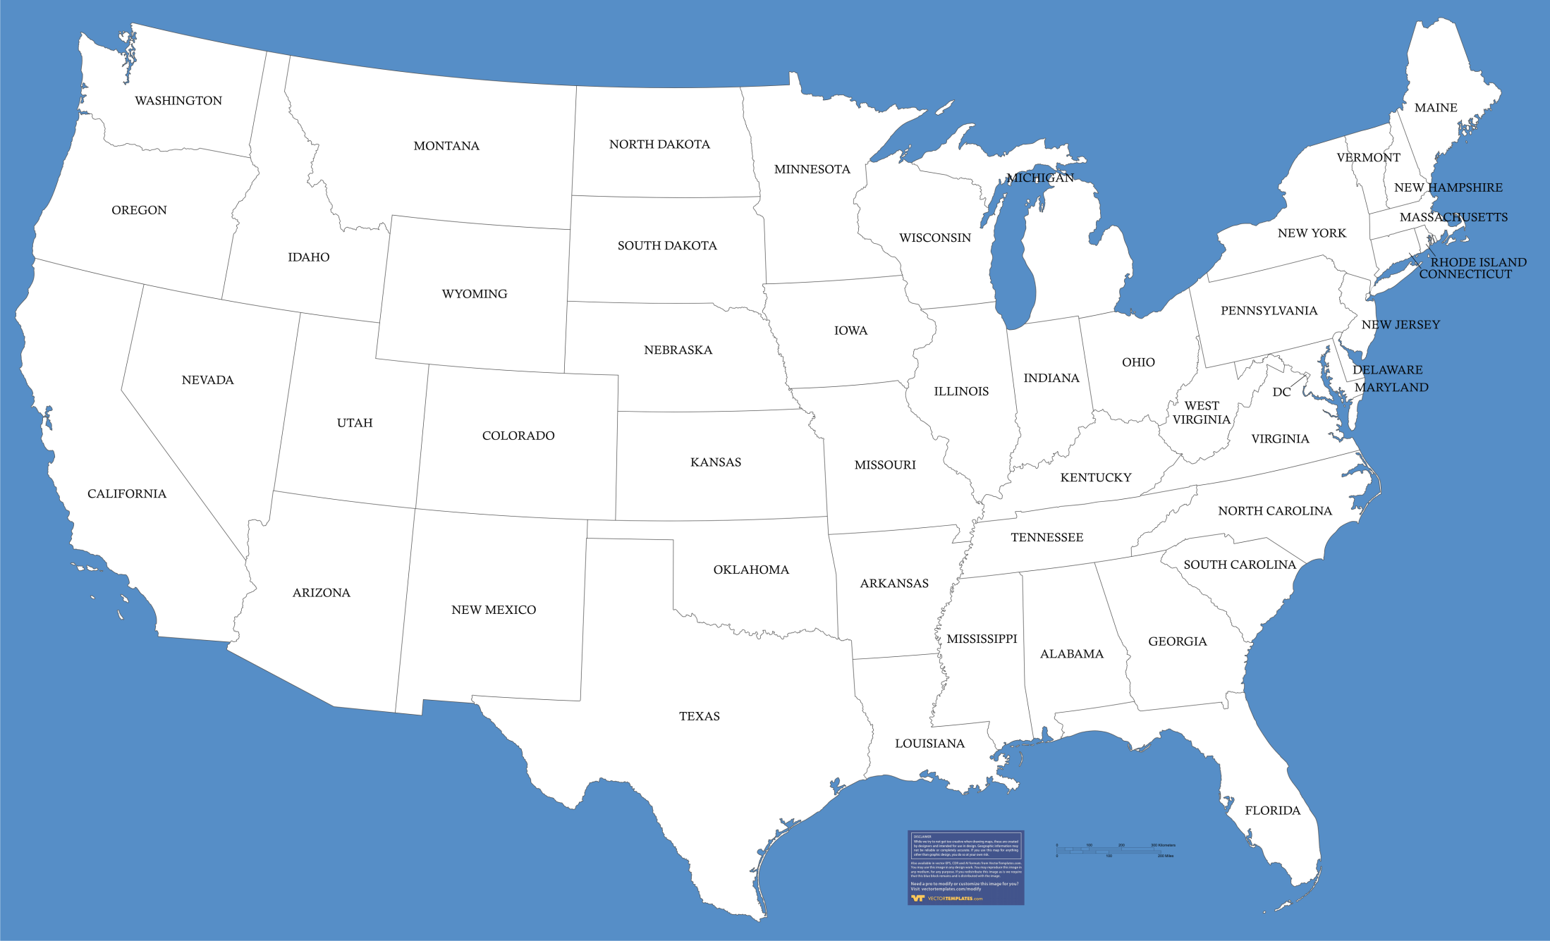
?
Courtesy of VectorTemplates.com
Notes:
Where is trich located now?

Slide 6
Historic Prevalence –
California (1988-1989) – 15.8% herds; 4.1% bulls
Nebraska/Colorado abattoirs (1988-1990) – 0.172% bulls
Idaho (1989-1990) – 4.4% herds; 1.63% bulls
Idaho (1990-1991) – 3.0% herds; 0.74% bulls
Florida (1995-1996 – 81.8% herds; 11.9% bulls
Florida (1997-1999) – 28.8% herds; 6.0% bulls
Alabama (2002-2005) – 0.27% bulls
Tennessee (2013-2016) – <0.01% bulls
Wyoming (2007-2010) – 2.17% herds

Slide 7
Nebraska Trich Counties

Slide 8
Nebraska Department of Agriculture
Animal & Plant Health Protection
Trichomoniasis Positives / Herds 2015 – 2023
Dr. Roger Dudley – State Veterinarian
Dr. Kaylie Fritts – Deputy State Veterinarian
1/1
2/2
2/1
1/1
1/1
15/2
1/1
5/1
3/1
2/1
2/1
1/1
12/1
4/1
1/1
# Positive / # Herds
3/1
4 / 4
2015 = 16 / 9
3/1
5/1
2/2
3/1
3/1
2016 = 23 / 5
2/1
1/1
2017 = 2 / 2
2018 = 17 / 2
3/1
2019 = 0
1/1
2020 = 1/1
2021 = 4/1
2022 = 15 / 9
2023 = 5 / 3

Slide 9
Cost of Infection
Computer simulation Rae 1989 J Am Vet Med Assoc 214:771-775
  14-50% reduction in calf crop
  12-30 day longer breeding season
  5-12% reduction in suckling period
  4-10% reduction in $ returned per calf born
  5-35% reduction in return per cow exposed
Computer simulation Villarroel 2004 J Am Vet Med Assoc 65:770-775
  Uncontrolled trich; 300 cows = ≤23% reduction in income
  $11.6 million lost in California

Slide 10
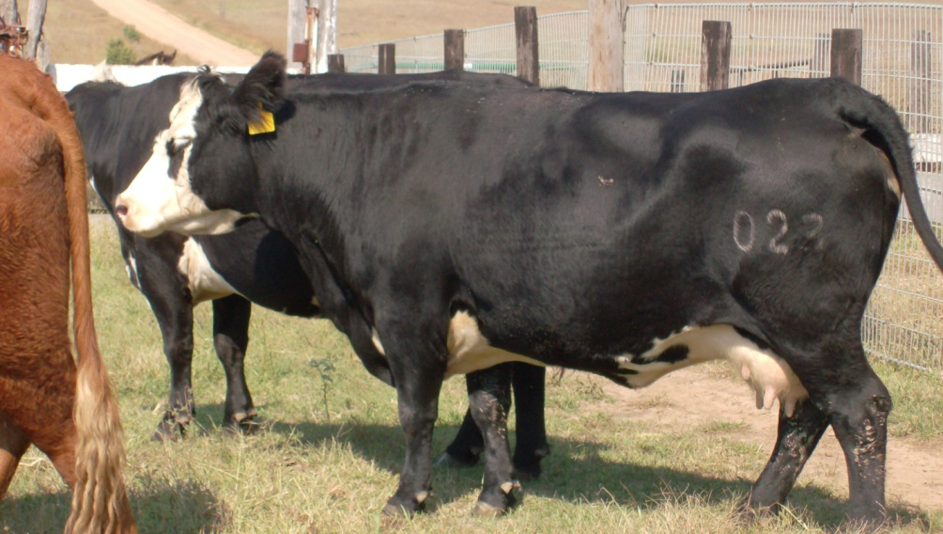
T. foetus in Females
Clinical Signs
Disease Process
Infection leads to inflammation, but does not interfere with conception
Early embryonic death and abortion at 50 – 80 days
Immune response clears infection
Infertility for 2-5 months => normal fertility
Unusual outcomes
Mild discharge
Return to estrus
Extended calving season
≥ 40% reduction in % pregnant cows
Notes:
NE herd: 68/150 head open (45%)

Slide 11
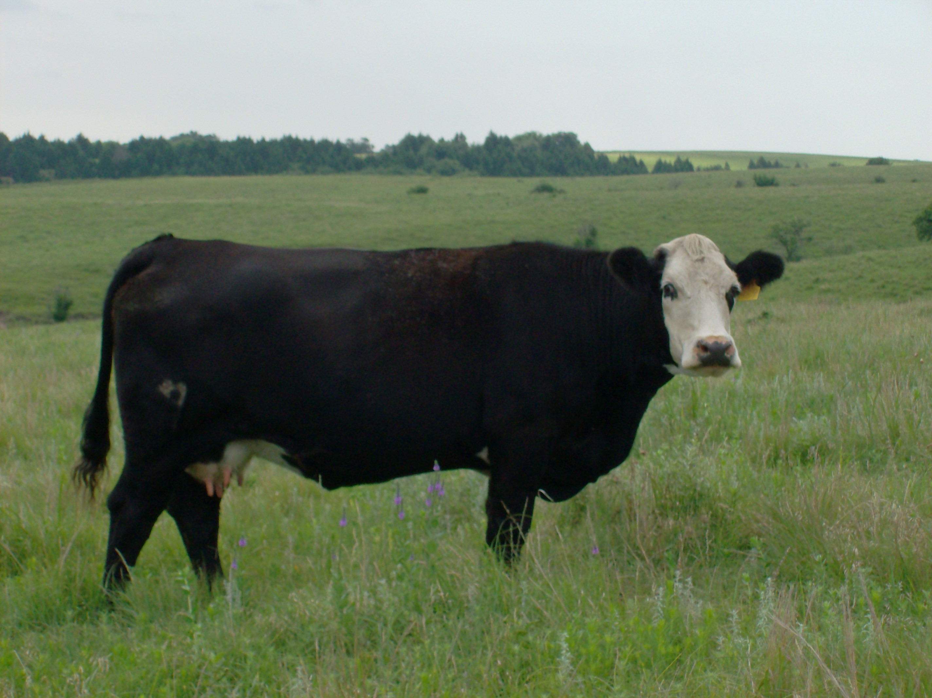
Unusual Outcomes
Pyometras
Abortions
Prolonged infections
  22 months Alexander Aust Vet J 1953
  300 days Mancebo et. al. Vet Parasitol 1995
Carrier cows
  63-97 days Goodger et. al. JAVMA 1986
  9 weeks Skirrow JAVMA 1987
Notes:
Prolonged infection = longer than expected infections without pregnancy
Carrier cows = cows that maintain infections through pregnancy, deliver a normal calf and then clear the infection at some point following parturition.

Slide 12
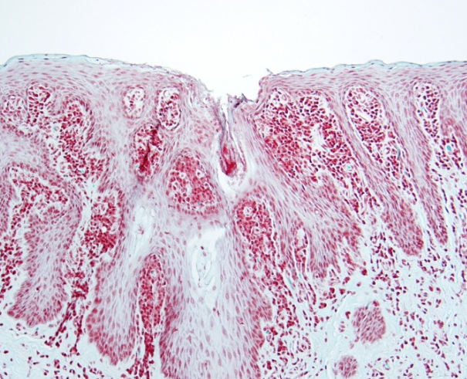
T. foetus in Males
Disease Process
Treatment
No tissue invasion
No detectable immune response
Preputial crypts aid in parasite survival?
Chronic carriers in bulls
> 3 years of age
Test and slaughter!
Clinical Signs
None
(Courtesy of Dr. Bruce Brodersen, University of Nebraska-Lincoln Veterinary Diagnostic Laboratory)
Notes:
The concept of preputial crypts is questionable so more work needs to be done in this area to understand why older bulls are more likely to be infected.

Slide 13
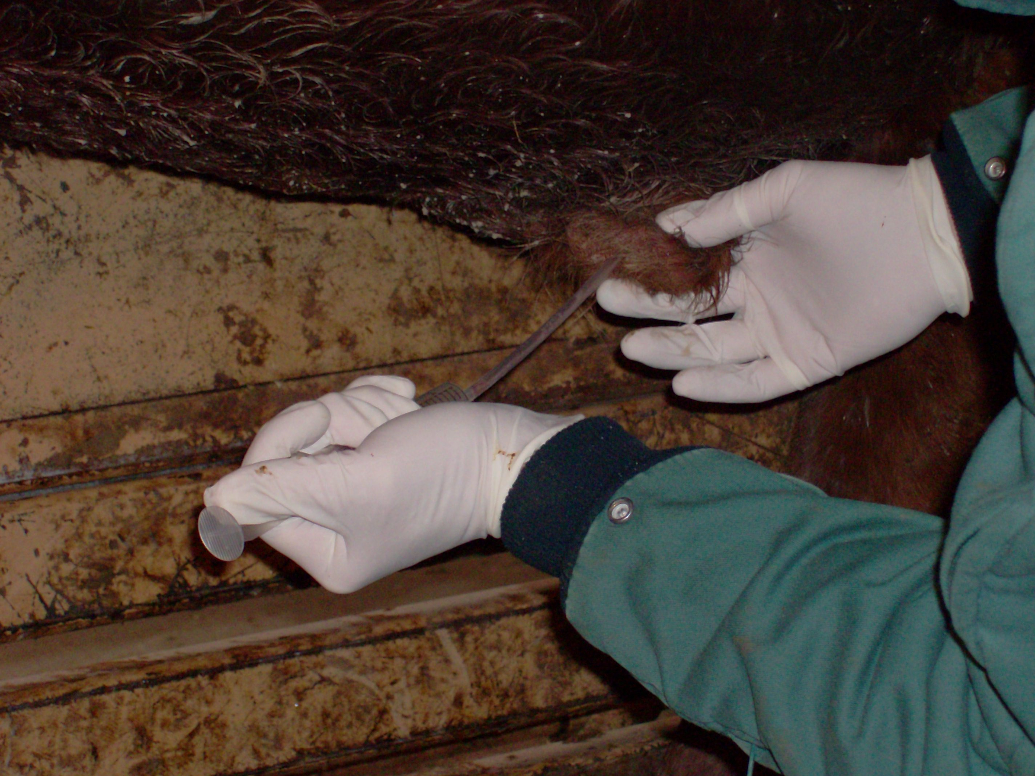
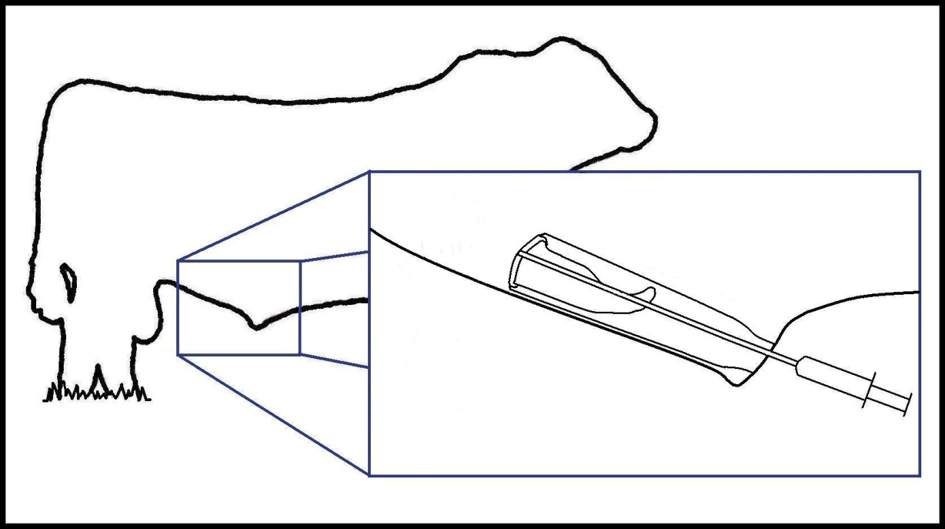

Slide 14
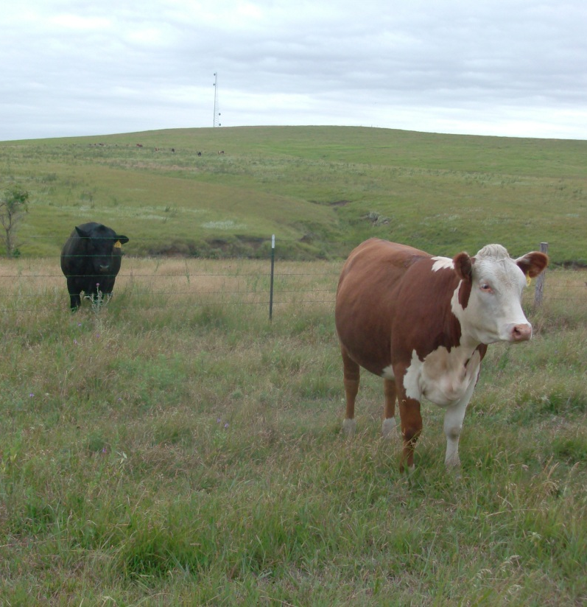
Herd Health Assurance:
At-risk Herds
Communication
  Veterinarian ⬄ producer
  Producer ⬄ producer
Planned grazing
Appropriate fencing
Monitor fences and cattle
Maintain a closed herd
Utilize artificial insemination
Observe regulations
Purchase only virgin or pregnant replacements
Isolate and test herd additions
Isolate and test herd reintroductions
Records
Surveillance testing

Slide 15
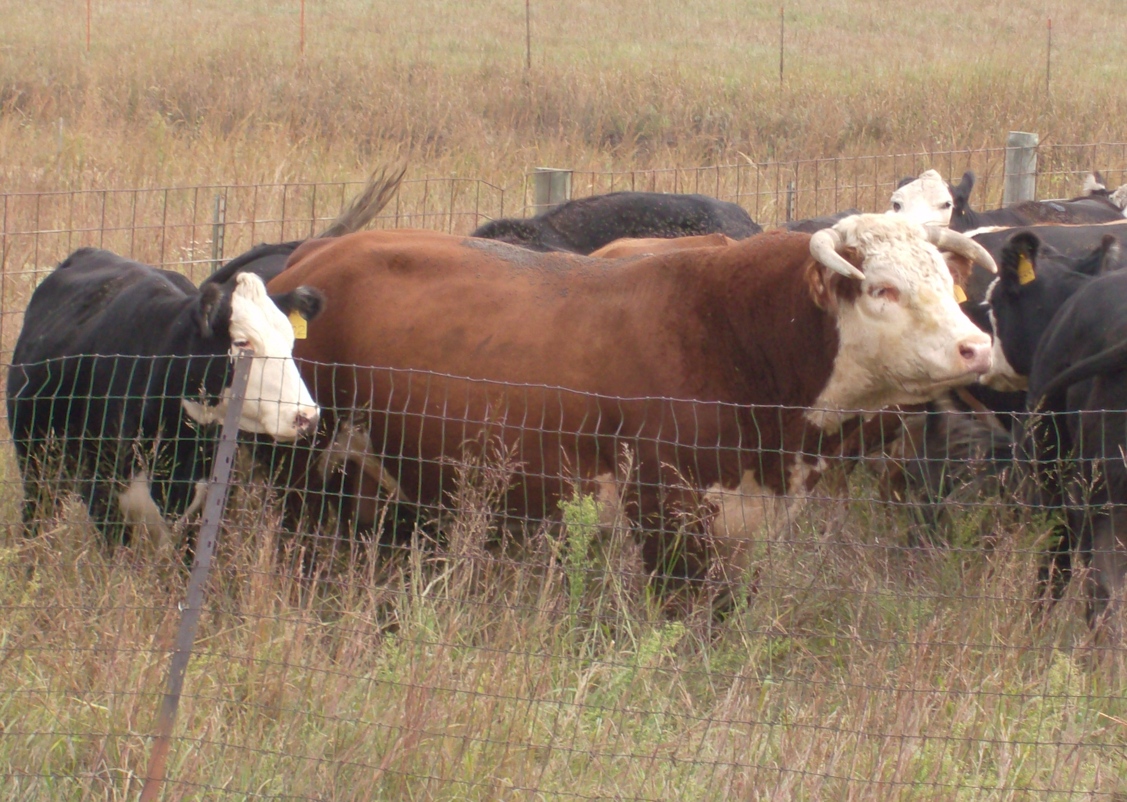
Herd Health Assurance:
Low Risk Herds
Communication
  Veterinarian ⬄ producer
  Producer ⬄ producer
Monitor fences and cattle
Maintain a closed herd
Utilize artificial insemination
Observe regulations
Purchase only virgin or pregnant replacements or purchase from a reputable source
Isolate and test herd reintroductions?
Records
Surveillance testing?????

Slide 16
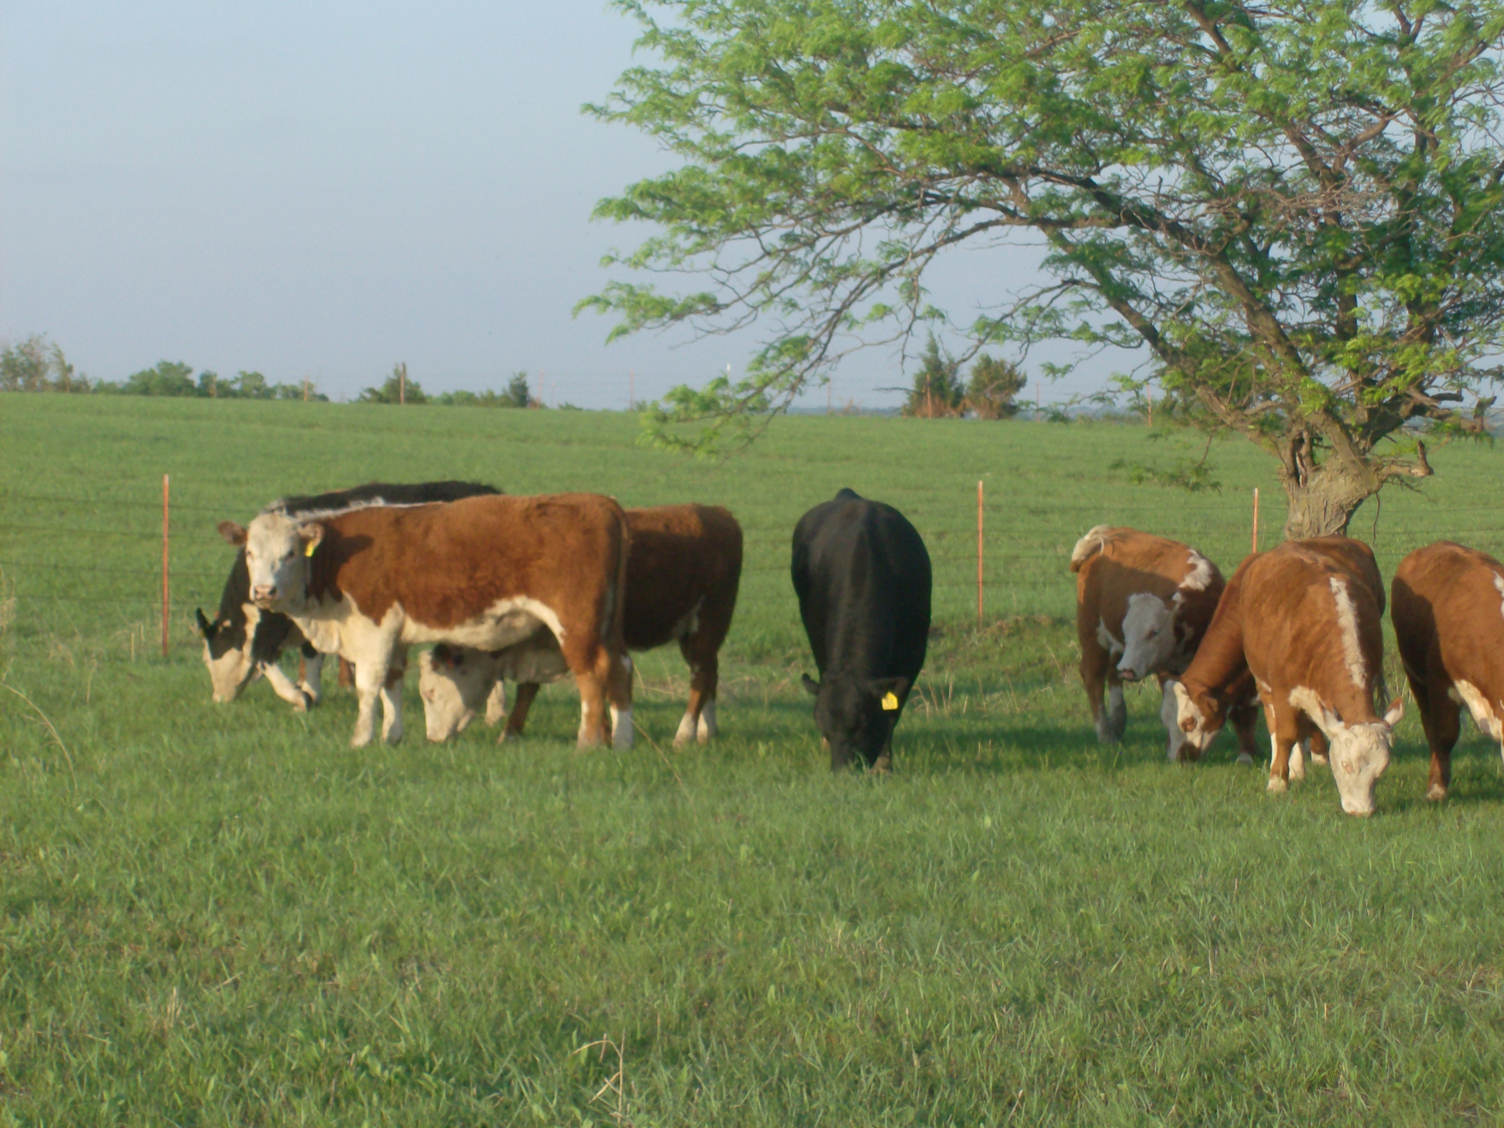
Herd Health Assurance:
Infected Herds
Communication
  Veterinarian ⬄ producer
  Producer ⬄ producer
Bull management
Test and cull
Cull
Utilize artificial insemination
Maintain a young bull battery
Cow management
Cull all non-productive cows, or
Establish “clean” and “dirty” herds
Records
Surveillance testing

Slide 17
“…it is my opinion that if more care was taken in the sale and purchase of barren cows, in the purchase of bulls of breeding age, and if the farmers could be sufficiently educated to the unique opportunities for control that this disease offers, then its total elimination should be practicable in the quite near future.”
H.P. Harding
The Veterinary Record
September 16, 1950

Slide 18
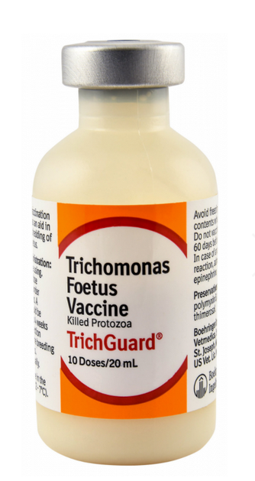
Vaccine
For vaccination of healthy cattle as an aid in the prevention of disease caused by Tritrichomonas foetus
Licensed to reduce shedding of Tritrichomonas foetus organisms
Dosage:
  Initial dose - 2 mL SQ
  Second dose 2 to 4 weeks later. The last injection should precede the breeding season by 4 weeks.
  Revaccinate annually

Slide 19
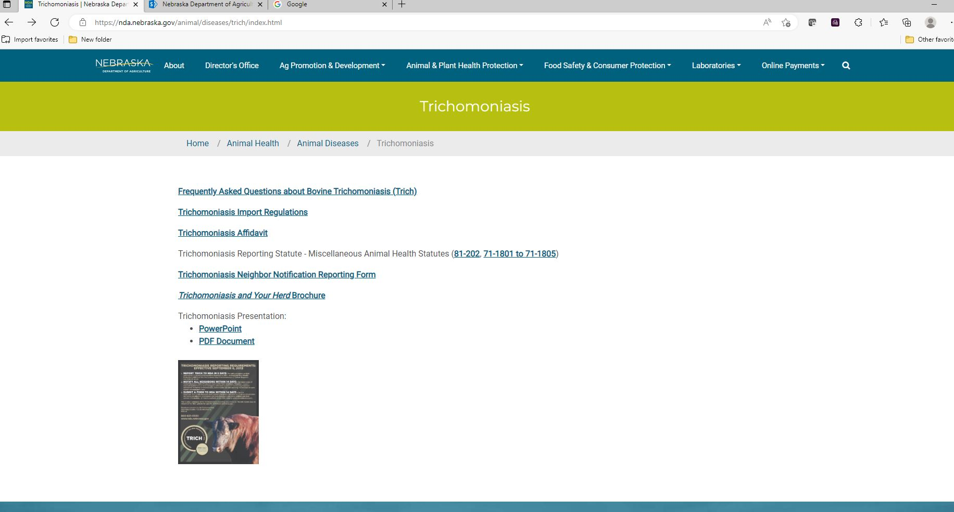
Notes:
This is an online tool to help producers and veterinarians learn about trich and develop a plan specific to their operation to prevent trich

Slide 20
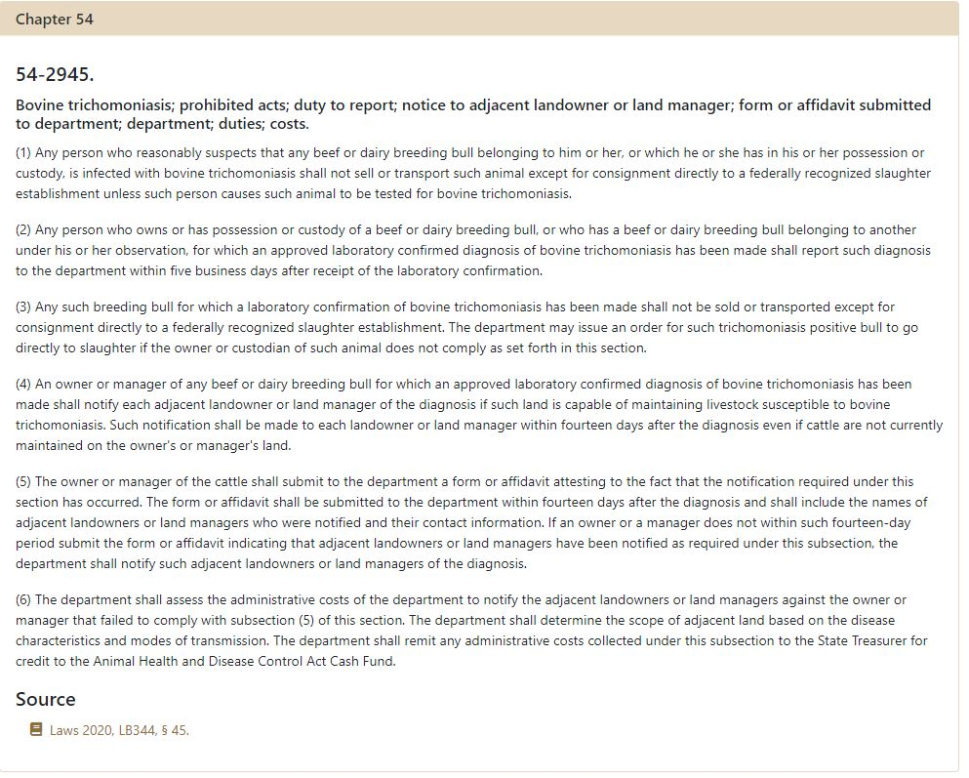

Slide 21
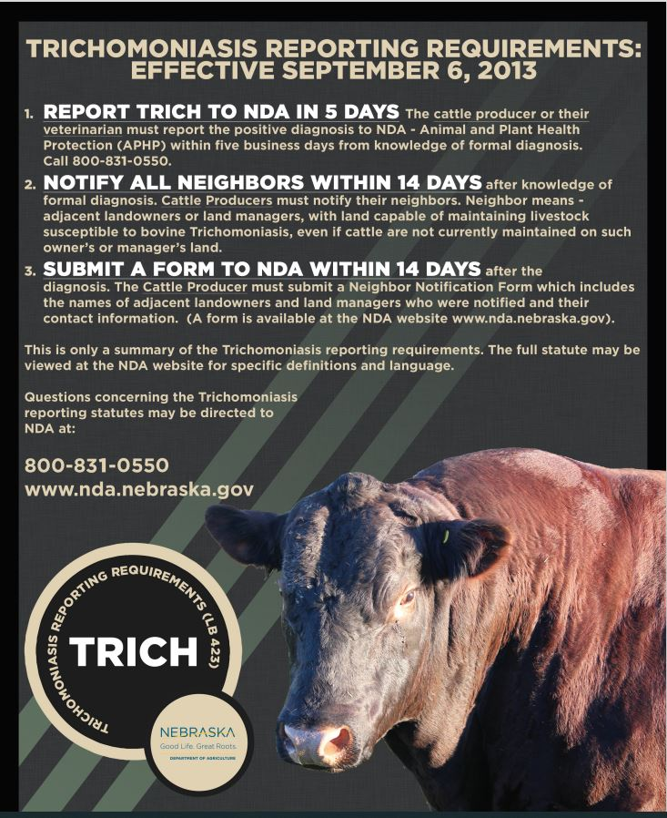

Slide 22
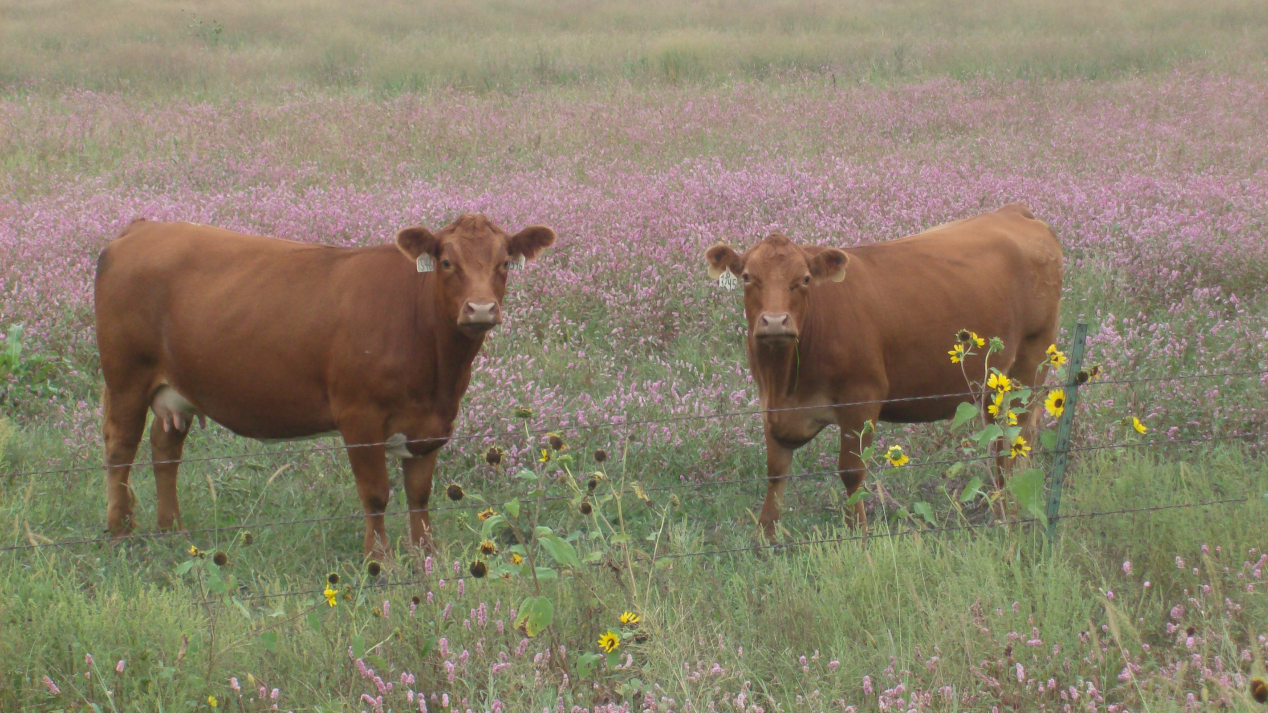
Questions
Questions?
Roger Dudley DVM
NE State Veterinarian
roger.dudley@nebraska.gov
402-471-2351

