Slide 1
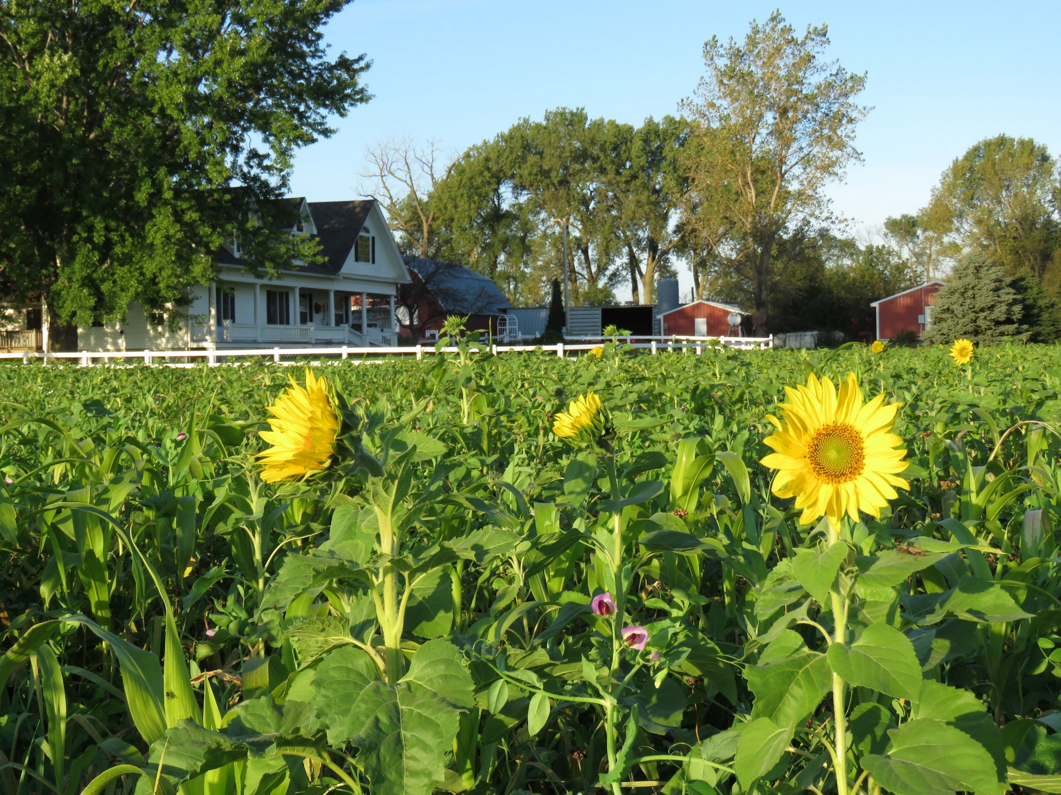
Soil Health Economics
Community based Regenerative Agriculture for the Health and Prosperity of Rural And Urban Nebraska

Slide 2
Measuring the Economic benefits of
Soil Health (The Hard Numbers)
Possible Incentives from supply chain sustainability programs

Slide 3
Measuring Soil Health Economics at Farm Level
--- Long term local Soil Health studies that track
input costs
--- Paul Jasa Rogers memorial farm, Duane Beck Dakota Lakes
research farm
---Develop Soil Health economic crop and livestock models
---Field to Market?

Slide 4
UNL Crop Budgets
Cost of production
2.77/bu
Need a budget for every enterprise
Don’t forget Livestock
Glennis McClure; UNL economist

Slide 5
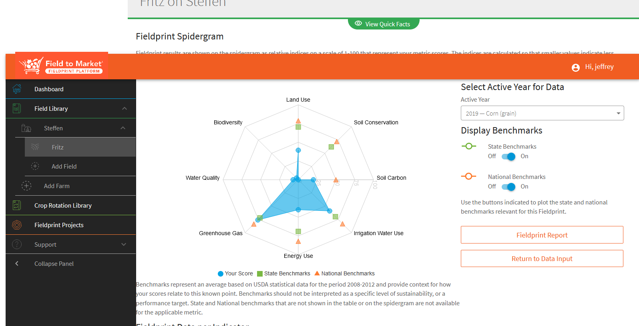
Field to Market Soil Health Report Card
Field to Market .Org

Slide 6
Soil Health Economics for “Everyone” in the State
--- UNL nitrogen application study
--- Cost of treating water for nitrates

Slide 7
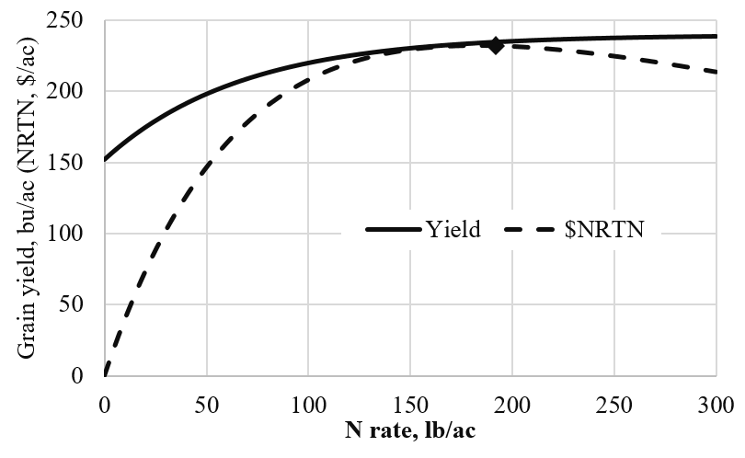
Charles Wortmann; UNL agronomy

Slide 8
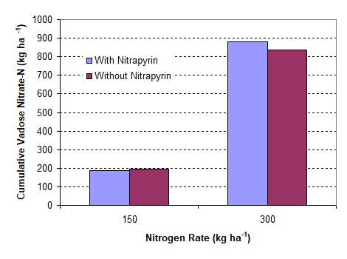
Charles Wortmann; UNL agronomy

Slide 9
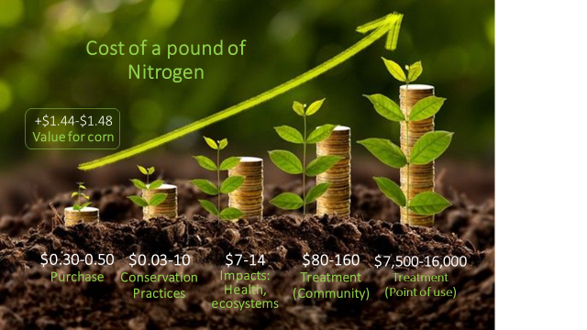
Crystal Powers; Nebraska Water Center

Slide 10
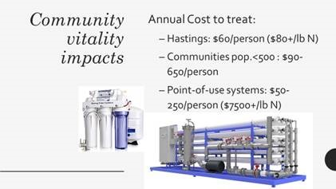
Crystal Powers; Nebraska Water Center

Slide 11
Supply Chain Sustainabilityprogram Incentives???
Fertilizer Institute…..4R Program
Land O Lakes
Field to Market and NRCS

Slide 12
NRD UNL NRCS Conservation.org’s
Dept of Ag Commodity Boards
Soil Health and
End Users Making Economic Decisions Land Managers
Ag Retail Bankers
Crop Consultants Coffee Shop
Farmer

Slide 13
NRD UNL Peer Group NRCS Conservation.org’s
Research Farm
Dept of Ag Farm Groups
End Users Land Managers
Ag Retail Bankers
Crop Consultants Coffee Shop
Farmer
Nebraska
Soil Health
Hub

Slide 14
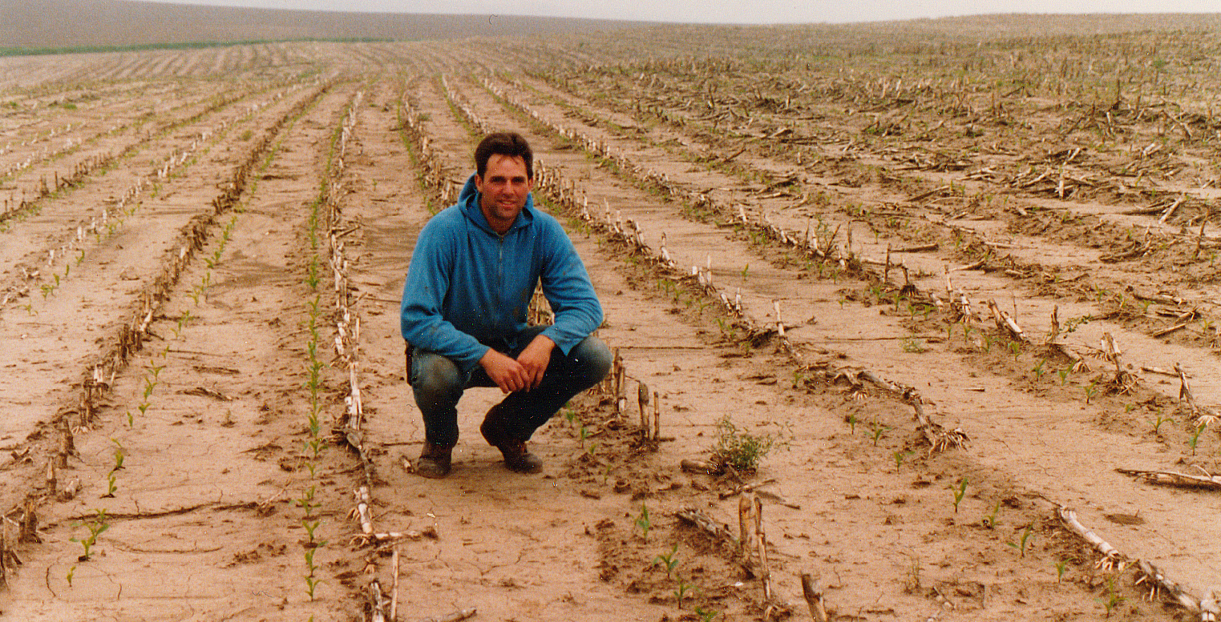

Slide 15
