Slide 1
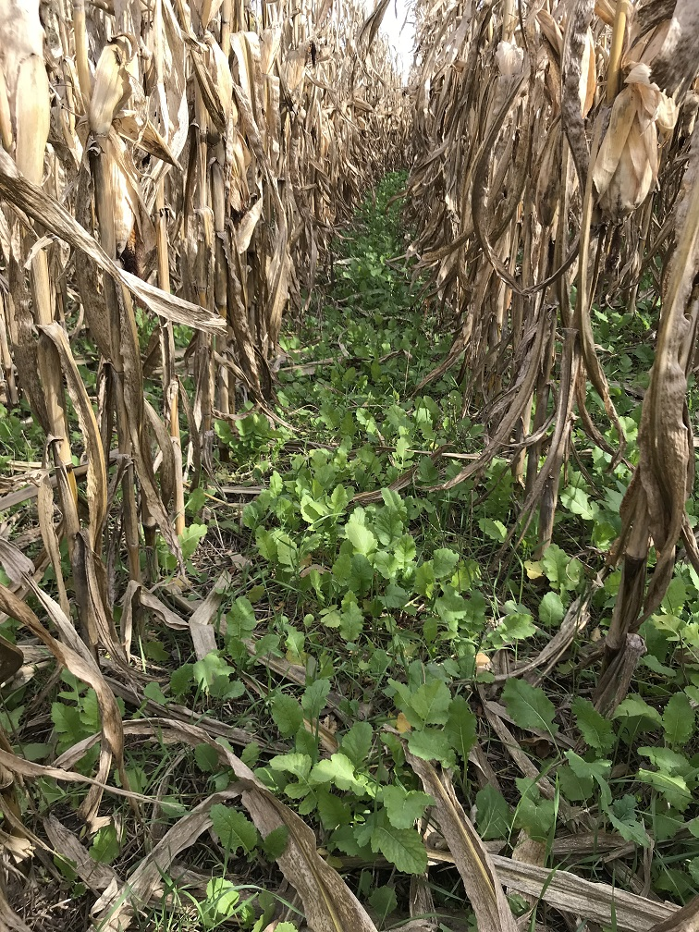
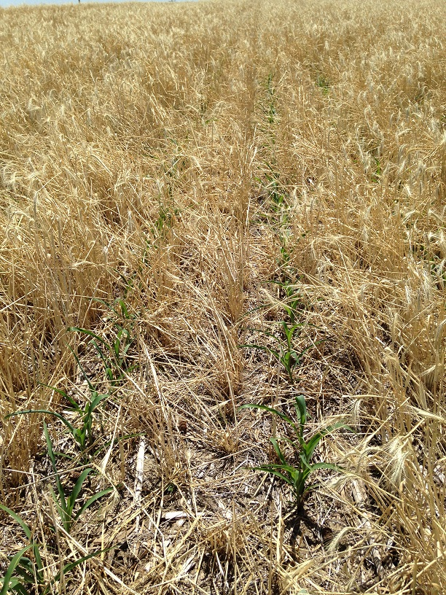
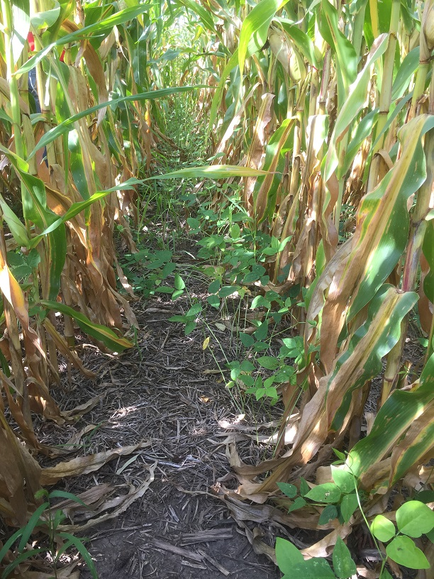
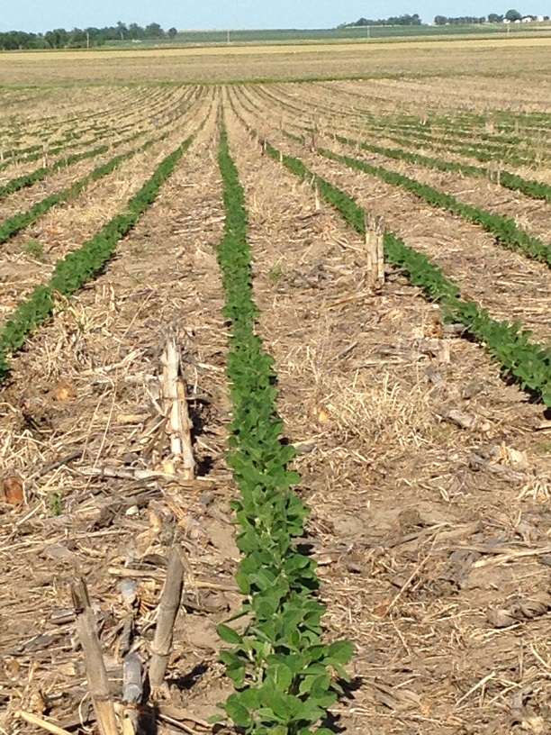
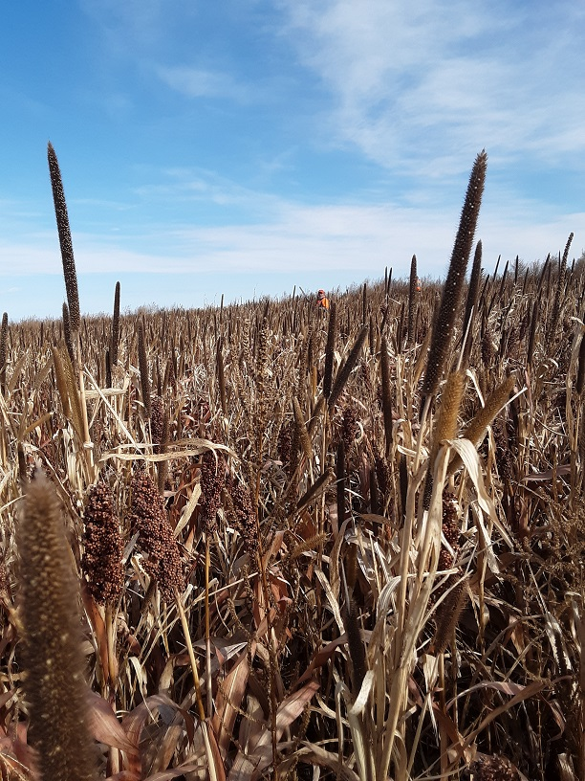
Healthy Soil
The Nebraska NRCS Soil Health Initiative
and USDA/NRCS Farm Bill Programs
By Aaron Hird, NE NRCS Soil Health Specialist

Slide 2
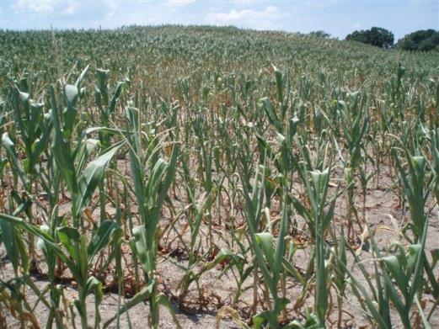
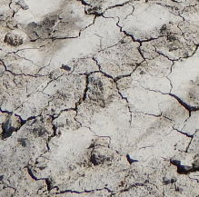
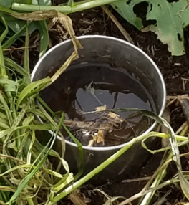
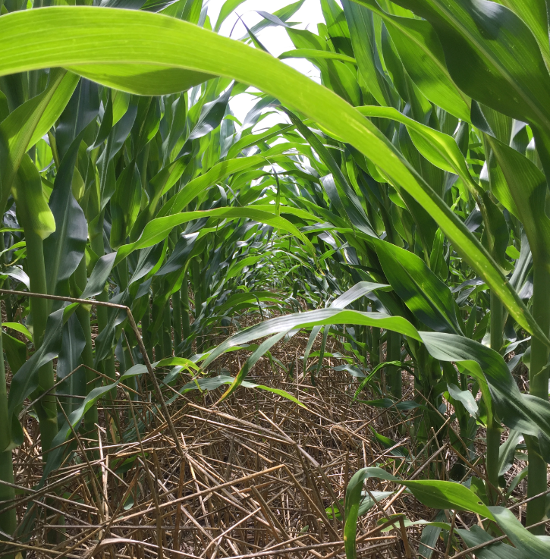
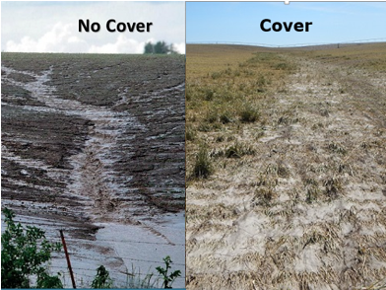
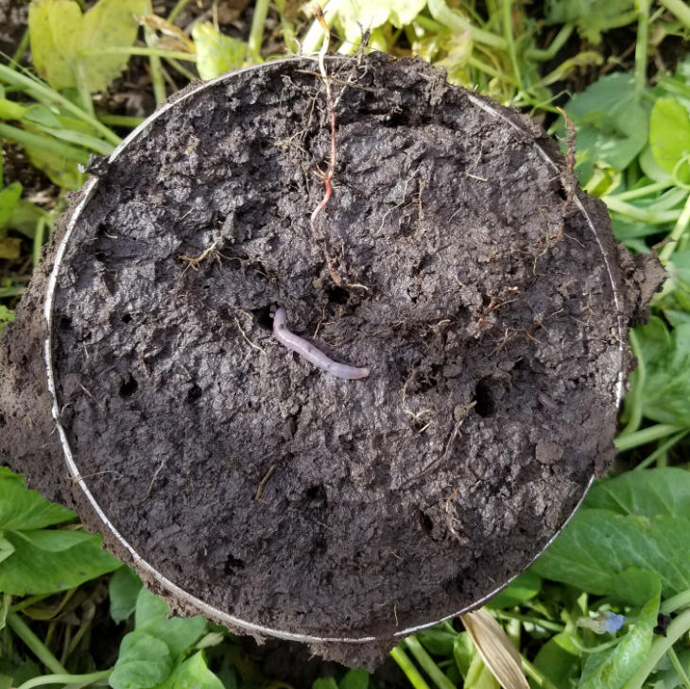
Extreme Weather
Resilient Soil

Slide 3
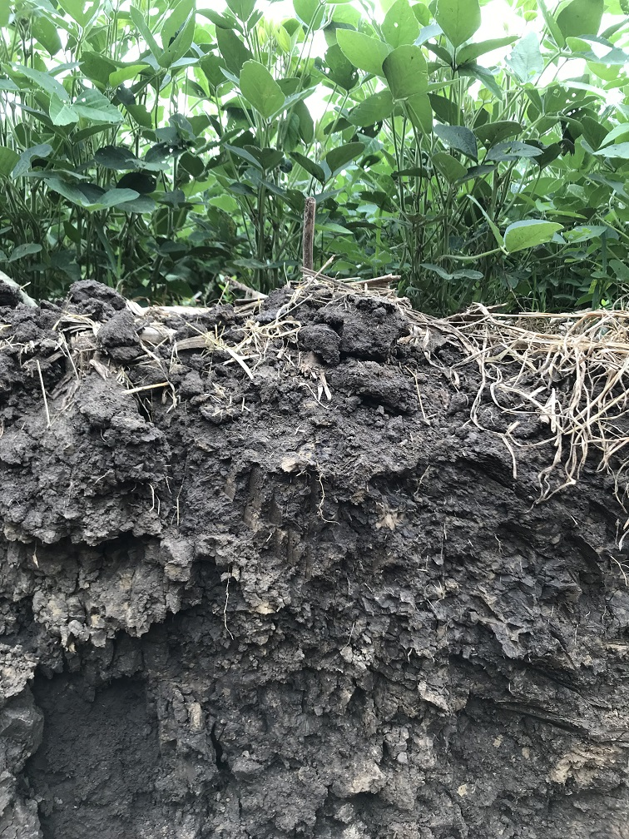
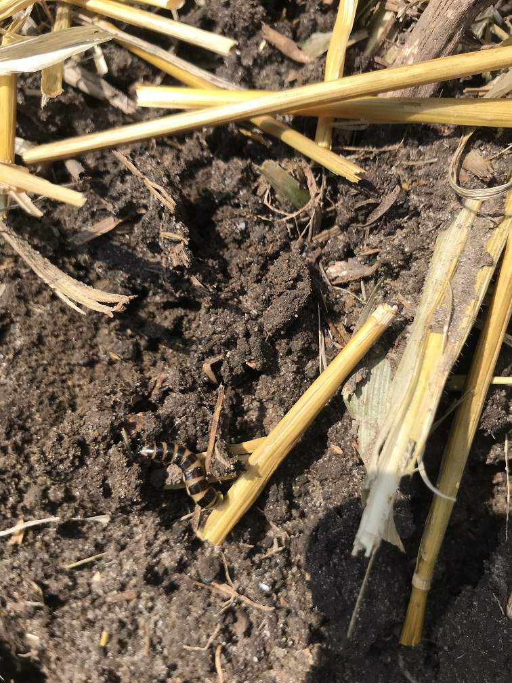
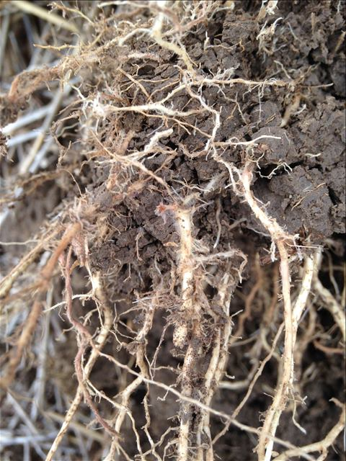
Soil Health Defined:
The continued capacity of the soil to function as a vital living ecosystem that sustains plants, animals, and humans.

Slide 4
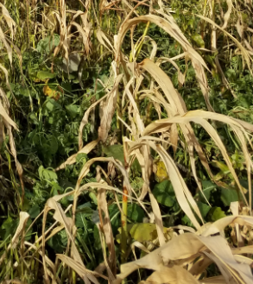
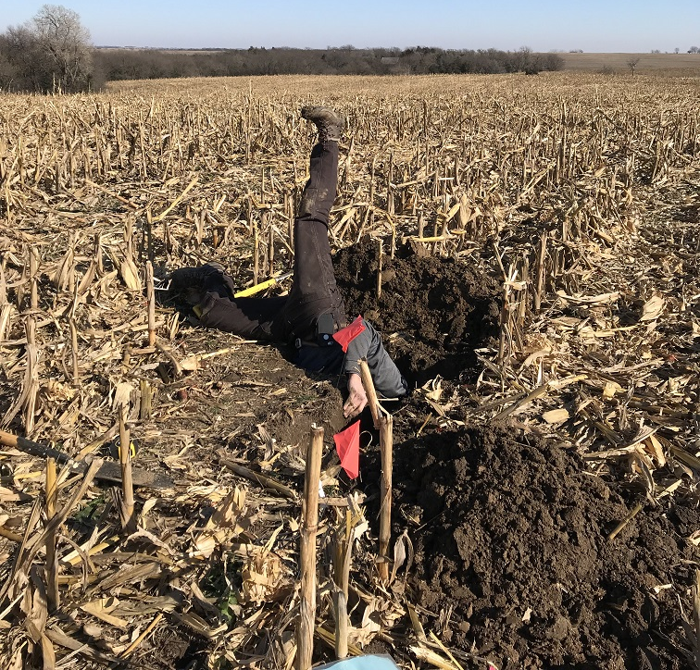
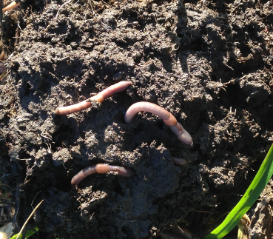
Is the Soil Healthy?
Soil Health is changed through natural processes and over time with management.
Every Soil has Unique Physical Properties developed by the 5 Soil Forming Factors: Time, Aspect, Parent Material, Climate, Biology.
Soil Function is influenced by biology which is impacted by management. (90% of Soil Function is mediated by soil microbes)
Supporting the biological activities can improve the Functions of the Soil.
Notes:
Just like in your body, by doing the right thing consistently, results accumulate!
These pictures show a soil slice from a continuous silage field. There were compaction layers every 2 inches like an accordion. This field had a 2% slope and had water erosion down every tire track. This is the first year of cover crops. I could see root growth resistance at each compaction layer but penetration did occur.
Next slide is the same field as these pictures.

Slide 5
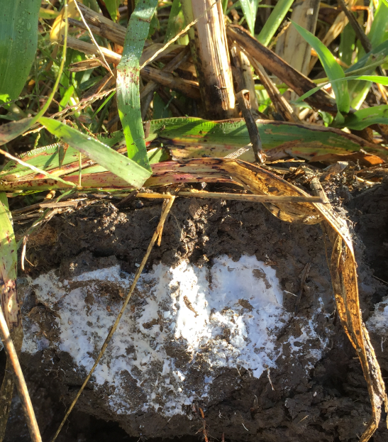
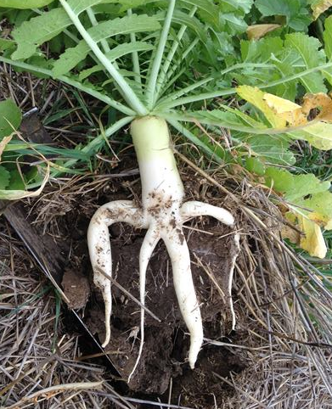
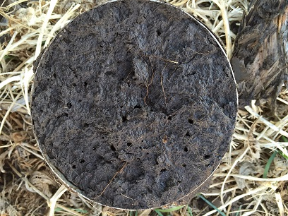
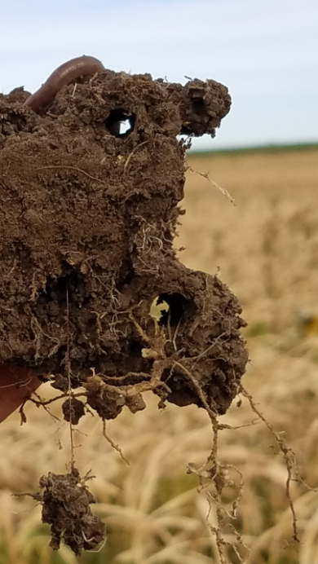
Soil Health Assessment is based on Dynamic Soil Properties
As the Dynamic Soil Properties change the Soil Functions change
Soil Functions Nutrient cycling Water (infiltration & storage) Filtering and Buffering Physical Stability and Support Habitat for Biological Activity
Dynamic Soil Properties
Biological Activity
Bulk Density
Color
Aggregate Stability
Structure
Notes:
If you have high blood pressure and your heart is working too hard, you are not considered healthy.

Slide 6
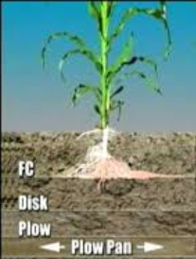
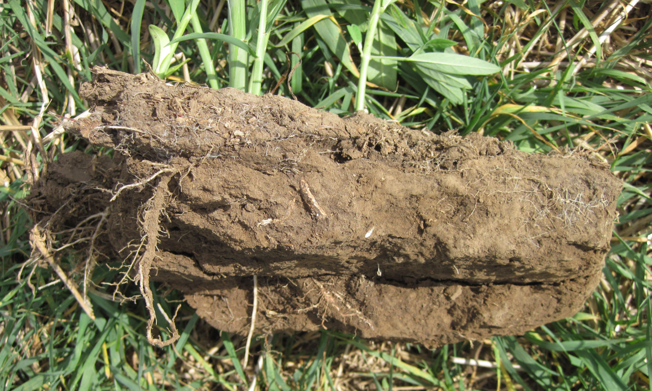
What do we have in Nebraska? Tillage Induced, Root Restrictive, Compaction Layers
2-4”
6-8”
12-16”
greatplainsmfg.com
In many soil types we have farmed the soil’s ability to withstand disturbance out of the top soil!

Slide 7
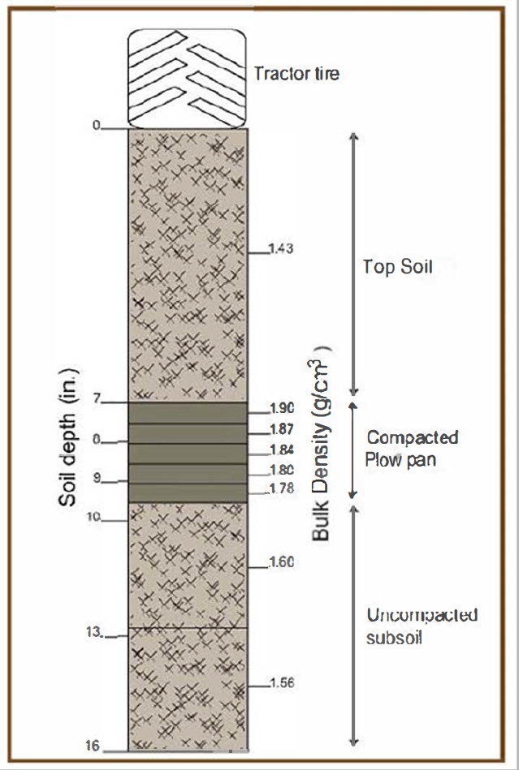
Root Restrictive Bulk Density
Note: The engineering standard soil bulk density is 1.33
- Top Soil = 1.43, Plow Pan starts at 1.90, ends at 1.78
- No Tillage systems Retain or Sustain soil structure.
- Biological Activity Regenerates soil structure.
- Cover Crops can have a HIGHER Rooting Pressure Tolerance

Slide 8
Building Resilient Soil is achieved by taking Step 1 - Implement the Soil Health Principles.
Minimize Disturbance
Maximize Soil Cover
Maximize Biodiversity
Provide Continuous Living Roots
Soil Health Principles
Integrating livestock is like greasing the wheels
Handouts provided

Slide 9
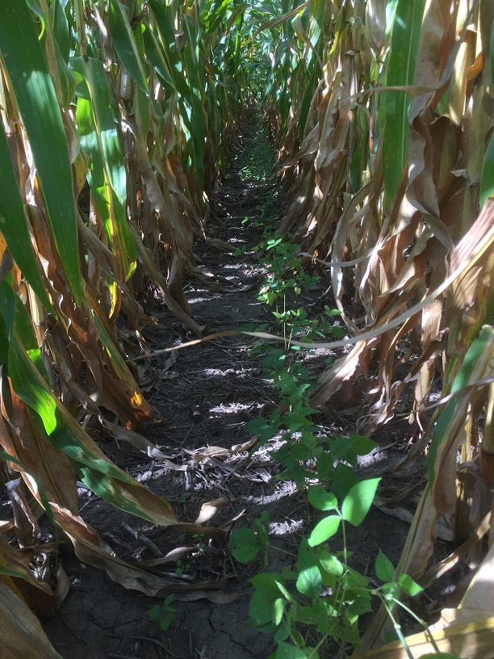
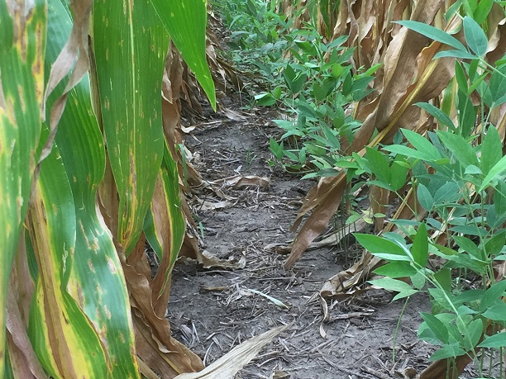
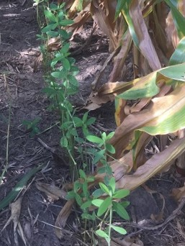
USDA/NRCS Conservation Programs
Environmental Quality Incentives Program (EQIP)
Conservation Practice Incentives
Physical Structures and Management Practices
Conservation Stewardship Program (CSP)
Conservation Stewardship Incentives
Management Enhancements
Regional Conservation Partnership Program (RCPP)
Regionally funded, targeted, Conservation Initiative
Matching the Conservation Investment of Partners
National Water Quality Initiative (NWQI)
Regionally funded, targeted, Conservation Initiative
Focused use of EQIP funds in to address critical concerns
Conservation Technical Assistance (CTA)
Conservation Planning, Design and Application
Voluntary participation

Slide 10
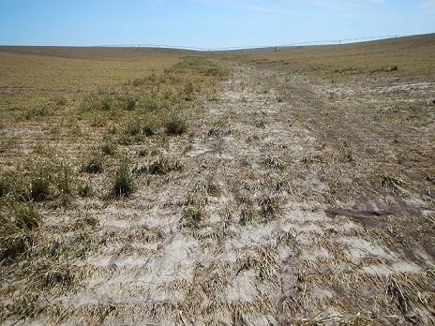
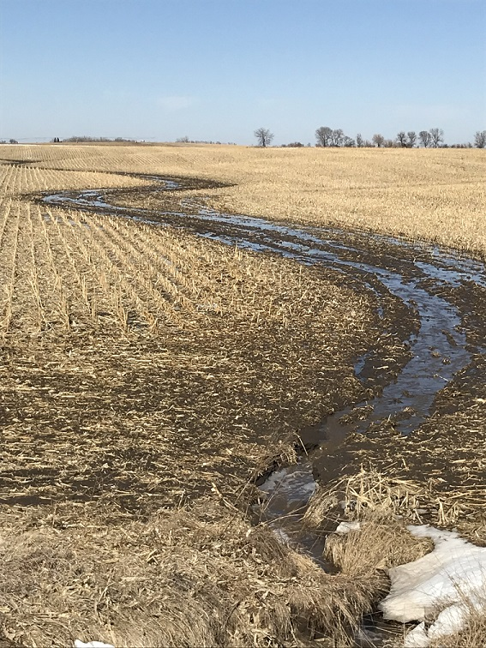
EQIP
Soil Health Management System Applying the Soil Health Principles
Conservation Crop Rotation (328)
Residue and Tillage Management (329)
Cover Crops (340) – Field wide or Critical Area
Forage and Biomass Planting (512)
Prescribed Grazing (528)
All Other Supporting Structural Practices…

Slide 11
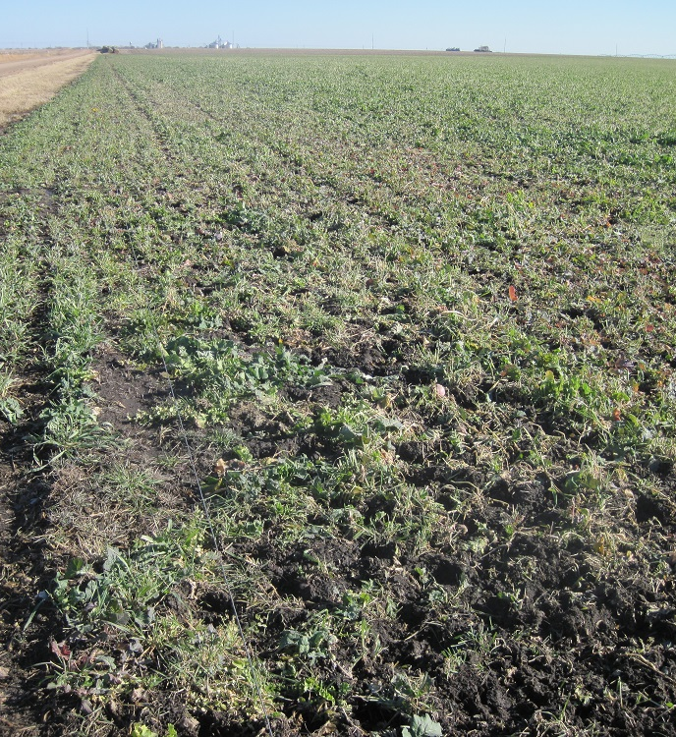
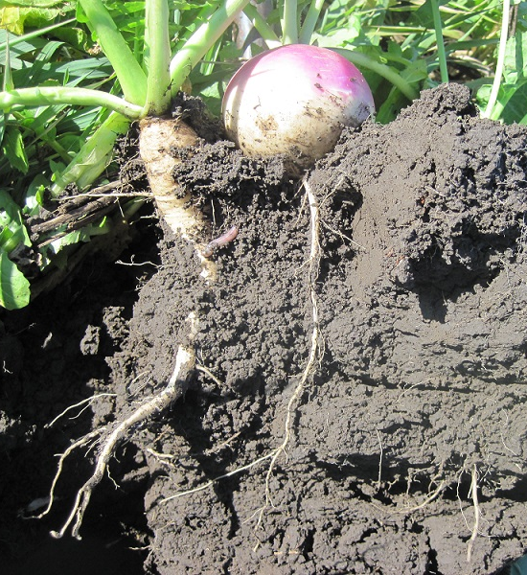
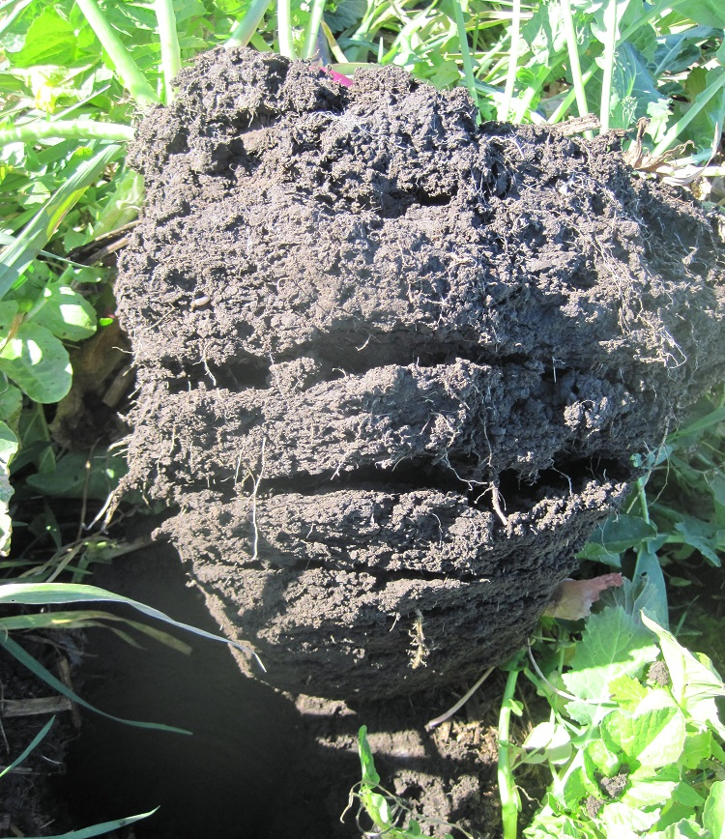
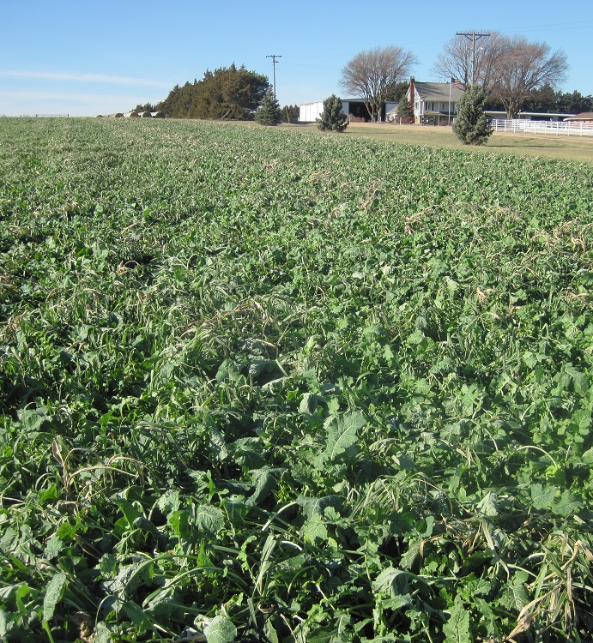
CSP
Whole Farm Conservation Plans
Enhancing Conservation Management
Cover Crop (340) Activities:
Erosion Control, Increase Soil Organic Matter, Minimize Soil Compaction, Utilize Excess Soil Nutrients, Suppress Weeds
Conservation Crop Rotation (328) Activities:
Reduce Erosion, Increase Soil Organic Matter, Improve Soil Health, Address Soil Compaction, decrease excess nutrients, relieve pest pressure, provide wildlife food, shelter and habitat

Slide 12
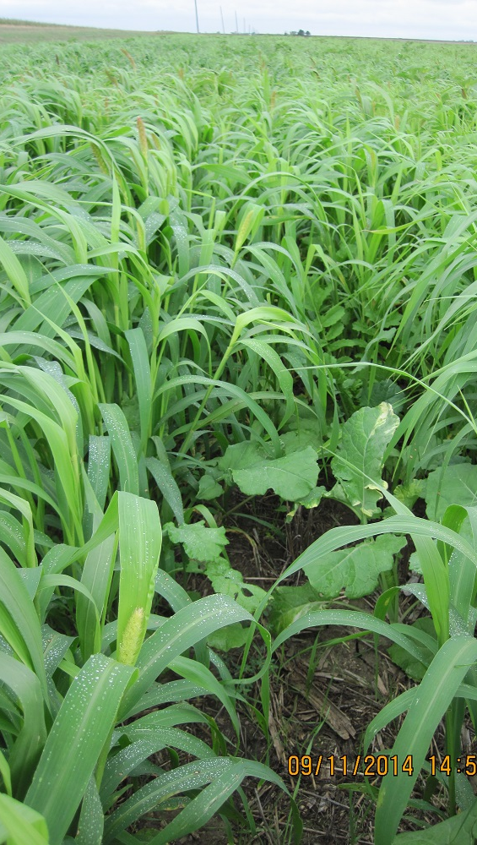
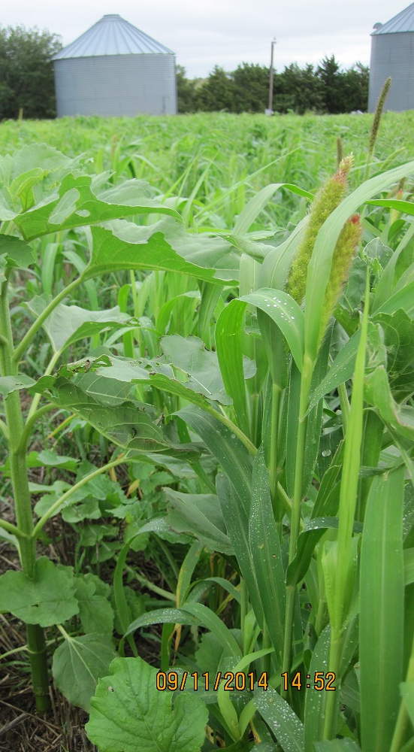
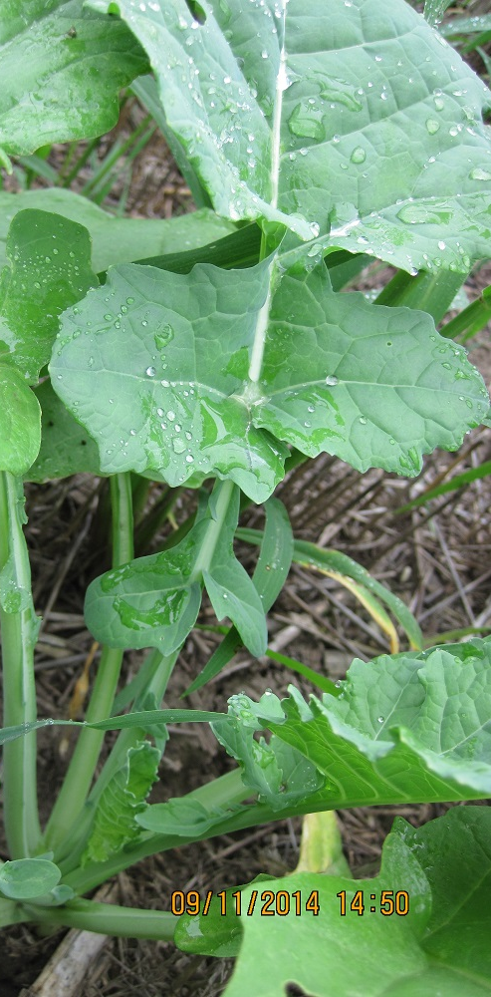
RCPP & NWQI
Regional Conservation Partnership Program and National Water Quality Initiative areas are a Regional USDA funding source for special EQIP Incentives
Matching funds from Conservation Partners
Geographically Targeted Areas – NRD, Watershed, Statewide
Addressing Priority Resource Concerns

Slide 13
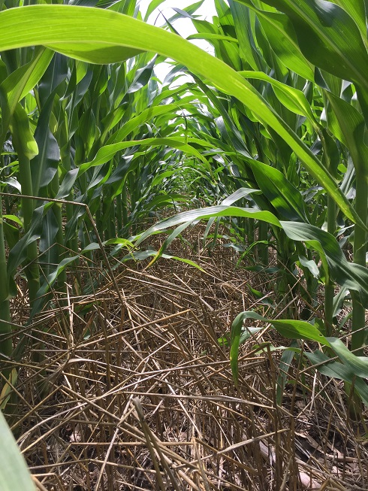
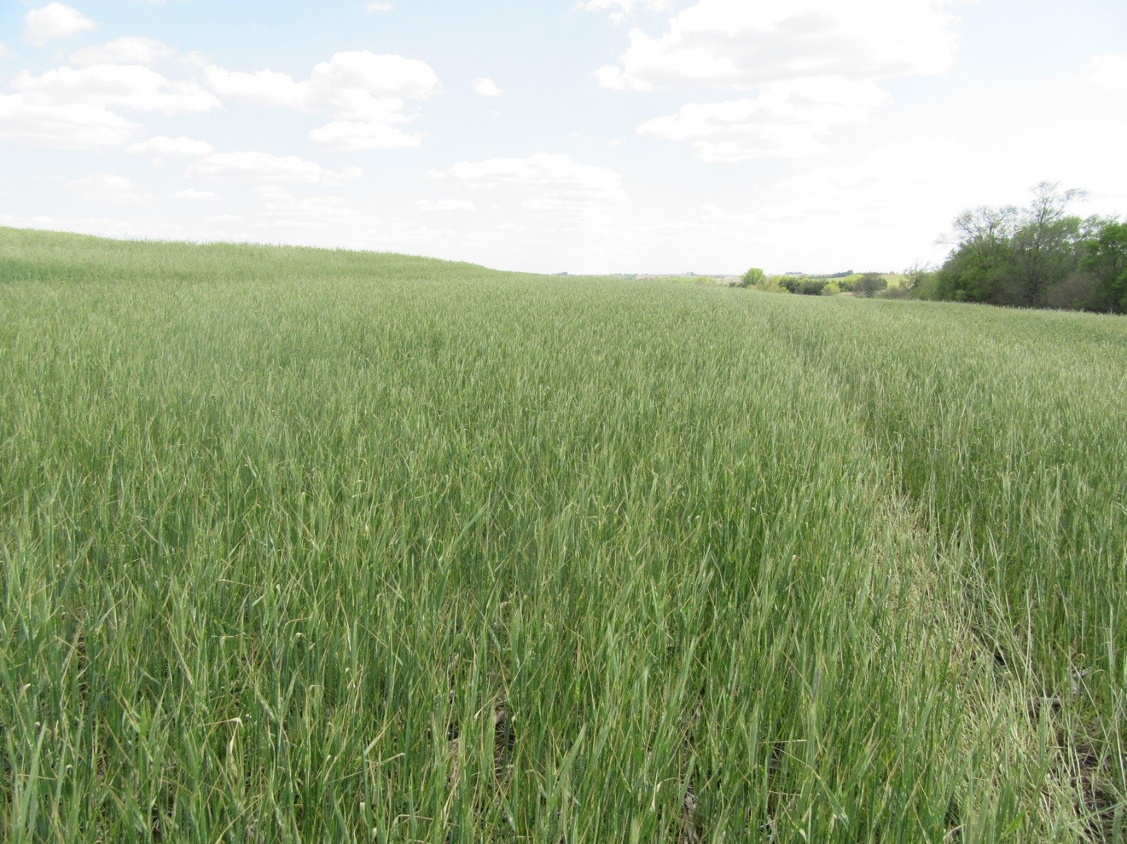
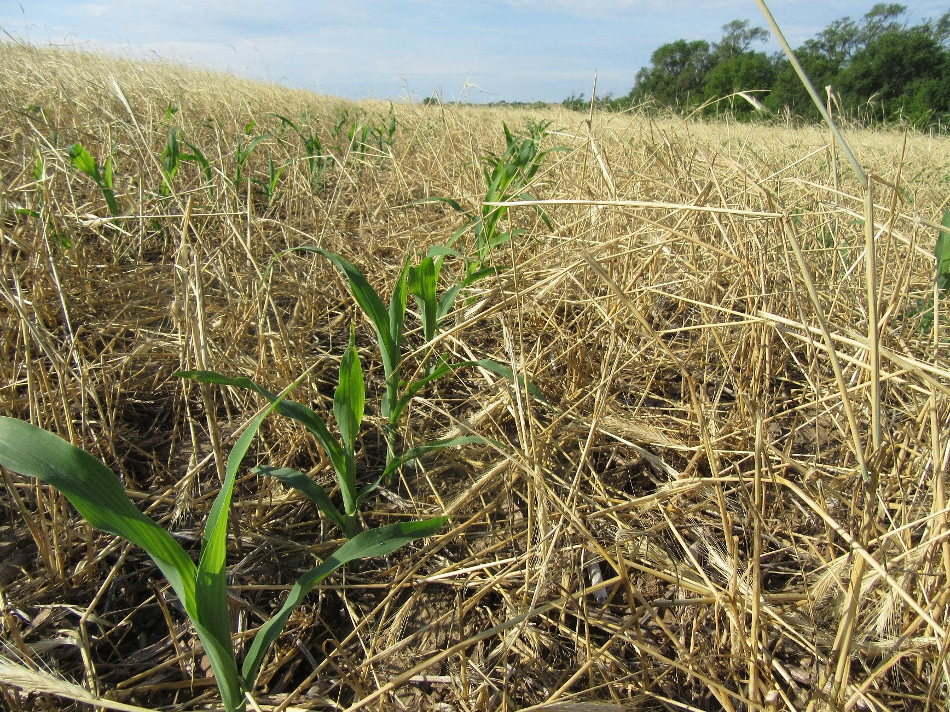
Program Incentives support a Learning Curve
The USDA/NRCS conservation incentives reduce the financial risk of the application of conservation work.
EQIP – 3 year contracts with incentive money
- Representing 50% of the estimated cost of the Conservation Practice
CSP – 5 year contracts providing stewardship payments
- Representing the cost of enhancing the Stewardship Practice
CTA – Technical Advice offered upon voluntary requests
June 30, 2017
May 1, 2017
June 5, 2017

Slide 14
2017 Census of Agriculture Data
The Director NASS explained, The Census allows for America to tell the changing story of agriculture by gathering information directly from farmers across the nation and has been conducted since 1840!
The Census of Agriculture provides the only source of comprehensive agricultural data for every State and county in the nation.
There was a 74.5% response rate in 2017.
The Census represents a key “Measurement of Success”.

Slide 15
Percentages of Harvested Nebraska Cropland By Tillage Practices,
2017 and 2012¹
2012
2017
Total cropland acres rose from 21,597,393 to 22,242,599 from 2012 to 2017.
¹ Source: USDA, National Agricultural Statistics Service. 2017 Census of Agriculture – Nebraska, Author: Diane Wasser , UNL

Slide 16
Nebraska
Source: USDA National Agricultural Statistics Service. 2017 Census of Agriculture, Author: Diane Wasser , UNL

Slide 17
Nebraska
Source: USDA, National Agricultural Statistics Service, 2017 Census of Agriculture – State Data , Author: Diane Wasser , UNL

Slide 18
State/Year | Acres In Cover Crops ² | % of Total Harvested Acres
Texas: 2017 2012 | 1,014,145 911,061 | 5.8 5.5
Iowa: 2017 2012 | 973,112 379,614 | 4.0 1.5
Indiana: 2017 2012 | 936,118 596,060 | 7.6 4.9
Missouri: 2017 2012 | 842,178 390,114 | 6.2 3.0
Nebraska: 2017 2012 | 747,903 357,264 | 3.8 1.9
Ohio: 2017 2012 | 717,759 357,292 | 7.0 3.5
Illinois: 2017 2012 | 708,105 318,636 | 3.1 1.4
Michigan: 2017 2012 | 673.205 437.200 | 7.3 6.2
Wisconsin: 2017 2012 | 611,231 553,005 | 6.6 6.0
Pennsylvania: 2017 2012 | 595,309 446,295 | 15.1 11.3
Top Ten States for Harvested Cropland Acres with Cover Crops: 2017 and 2012¹
¹ Source: USDA National Agricultural
Statistics Service, 2017 Census of
Agriculture – State Data , Author: Diane Wasser, UNL
² Excluding CRP Acres

Slide 19
Percent of Nebraska Farms Reporting Cover Crops by Acreage – Size Class of Farms, 2012 and 2017 ¹
Farm Acreage Size Class | Year |  | % Change 2012-2017
 | 2012 | 2017
1 to 99 acres | 65% | 52% | -24.3%
100 to 499 acres | 30% | 40% | 114.1%
500 to 999 acres | 3% | 5% | 150.5%
1000 to 1999 acres | 1% | 2% | 121.6%
2000 or more acres | <1% | <1% | 16.7%
The total number of farms in Nebraska: 49,969 in 2012, 46,332 in 2017.
¹ Source: USDA, National Agricultural Statistics Service, 2017 Census of Agriculture – Nebraska , Author: Diane Wasser , UNL

Slide 20
Nebraska Cover Crops Acres Reported by Acreage – Size Class of Farms, 2012 and 2017 ¹
Farm Acreage Size Class | Year |  | % Change 2012-2017
 | 2012 | 2017
 | - - - - - - - Acres - - - - - - - |  | Percent
1 to 99 acres | 62,593 | 87,308 | 39.5
100 to 499 acres | 167,267 | 390,340 | 133.4
500 to 999 acres | 60,360 | 150,782 | 149.8
1000 to 1999 acres | 46,156 | 98,707 | 113.9
2000 or more acres | 20,888 | 20,766 | 0.69
TOTAL | 357,264 | 747,903 | 109.3
¹ Source: USDA, National Agricultural Statistics Service, 2017 Census of Agriculture – Nebraska , Author: Diane Wasser , UNL

Slide 21
Total vs. USDA Conservation Program Cover Crop Acres
State/Year | Acres In Cover Crops ^{1,2} | % of Total Harvested Acres
Nebraska: 2017 2012 | 747,903 ac 357,264 ac | 3.8 1.9
Program/Year | Acres In Cover Crops | Program $
EQIP - 2017³ | 61,920.9 ac | $2,748,767.27
CSP – 2017³ | 4,850.7 ac | $36,316.75
Total Acres | 66,771.6 ac | $2,785,083.90
2017 Program Funded Percent of Total | % of 2017 Total Cover Crop Acres 8.9% | % of Total Harvested Acres 0.3%
2019 Program Funded Disaster Recovery³ | ~42,339.54 acres | ~$1,484,027.00
¹ Source: USDA National Agricultural Statistics Service, 2017 Census of Agriculture – State Data
² Excluding CRP Acres
³ USDA - NRCS

Slide 22
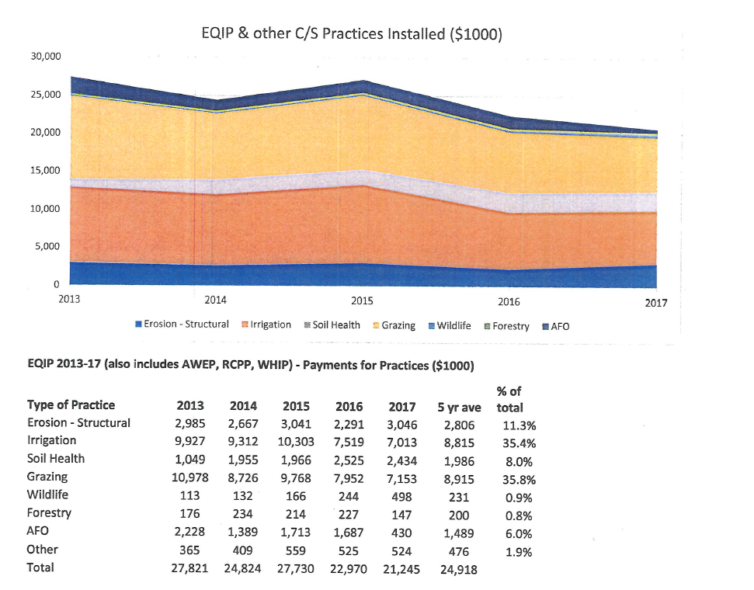
EQIP Funds Trending 2013-17
EQIP:
Soil Health Practices:
Cover Crops
Residue and Tillage Management (No Till)
Conservation Crop Rotation
Bottom
Top

Slide 23
Incentive and Enhancement Rates
EQIP – Multi Species Cover Crop Incentive
2017 - $43.63/ac Max $10,000/person/year
2018 - $44.36/ac Max $10,000/person/year
2019 – $33.97/ac Max $7500/person/year
CSP – Multi Species Cover Crop Enhancement Rate
2017 – Cover crop - $9.70/ac
2018 – Cover crop - $9.86/ac
2019 – Cover crop - $9.44/ac

Slide 24
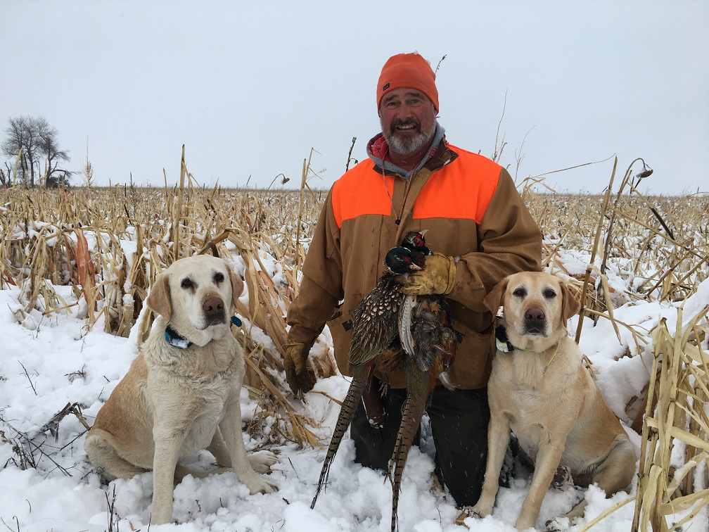
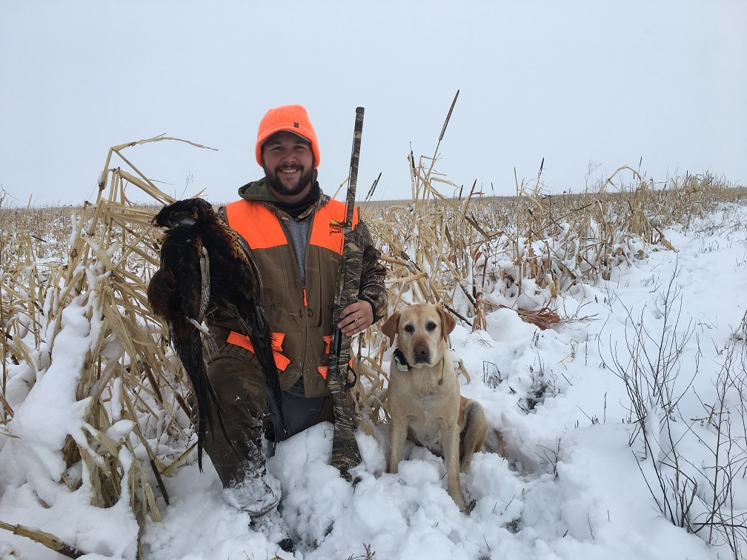
Cover Crops for Wildlife Habitat
Pictures by Aaron Herring
RCPP with Nebraska Game and Parks Commission in Hitchcock, Red Willow and Furnas Counties
Cover Crop & Access Control w/ Loss of Forgone Income - $61.20/ac
2017- 5 contracts, 2018 – 20 contracts, 2019 – 46 contracts
The concept can now be applied statewide

Slide 25
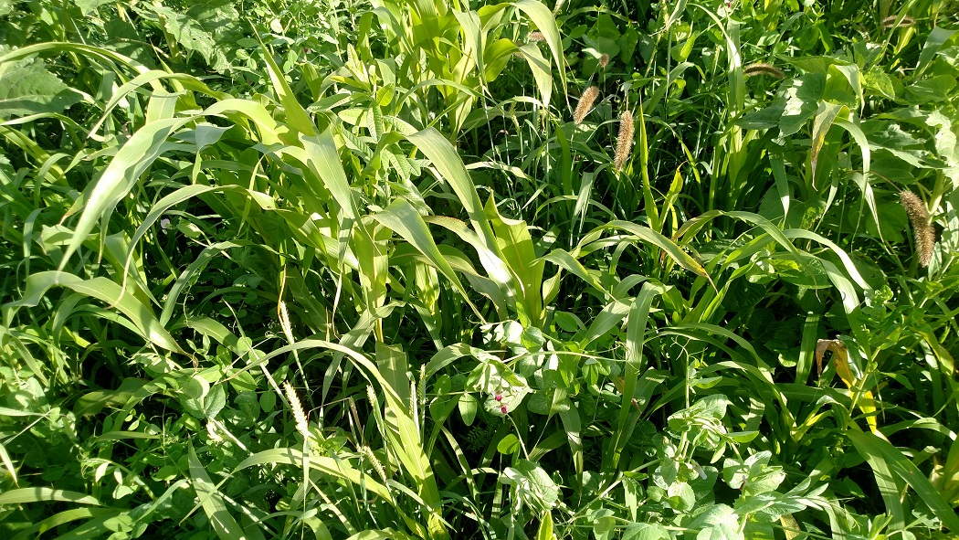
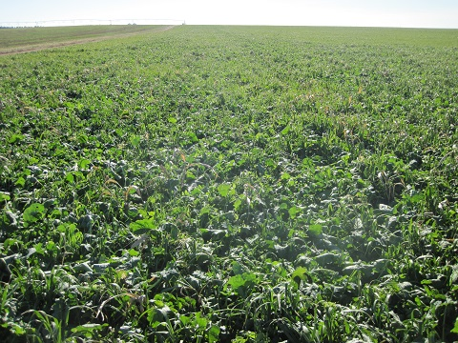
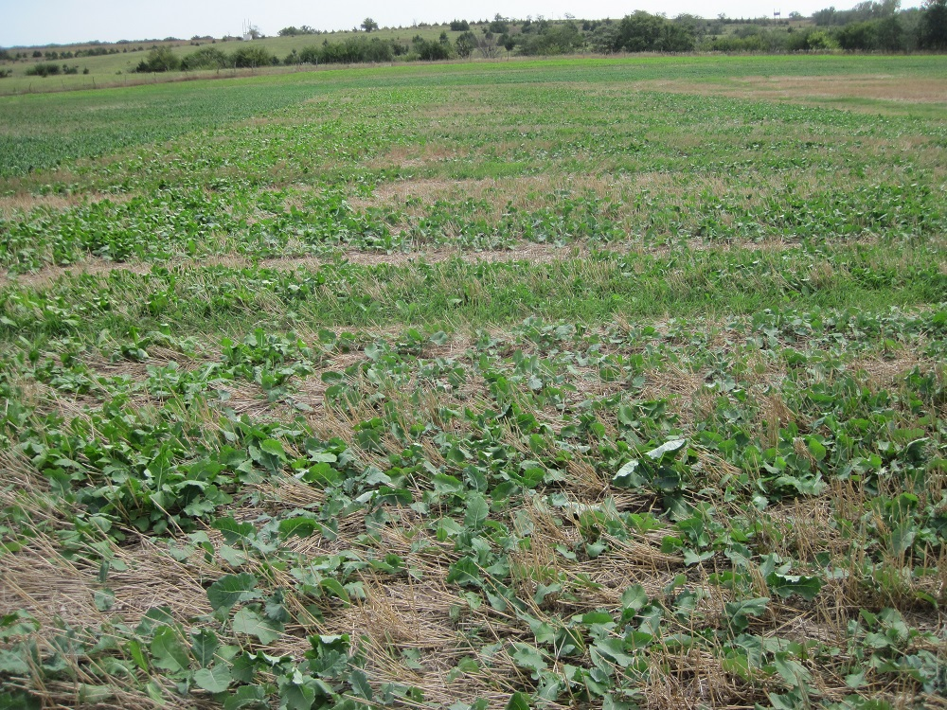
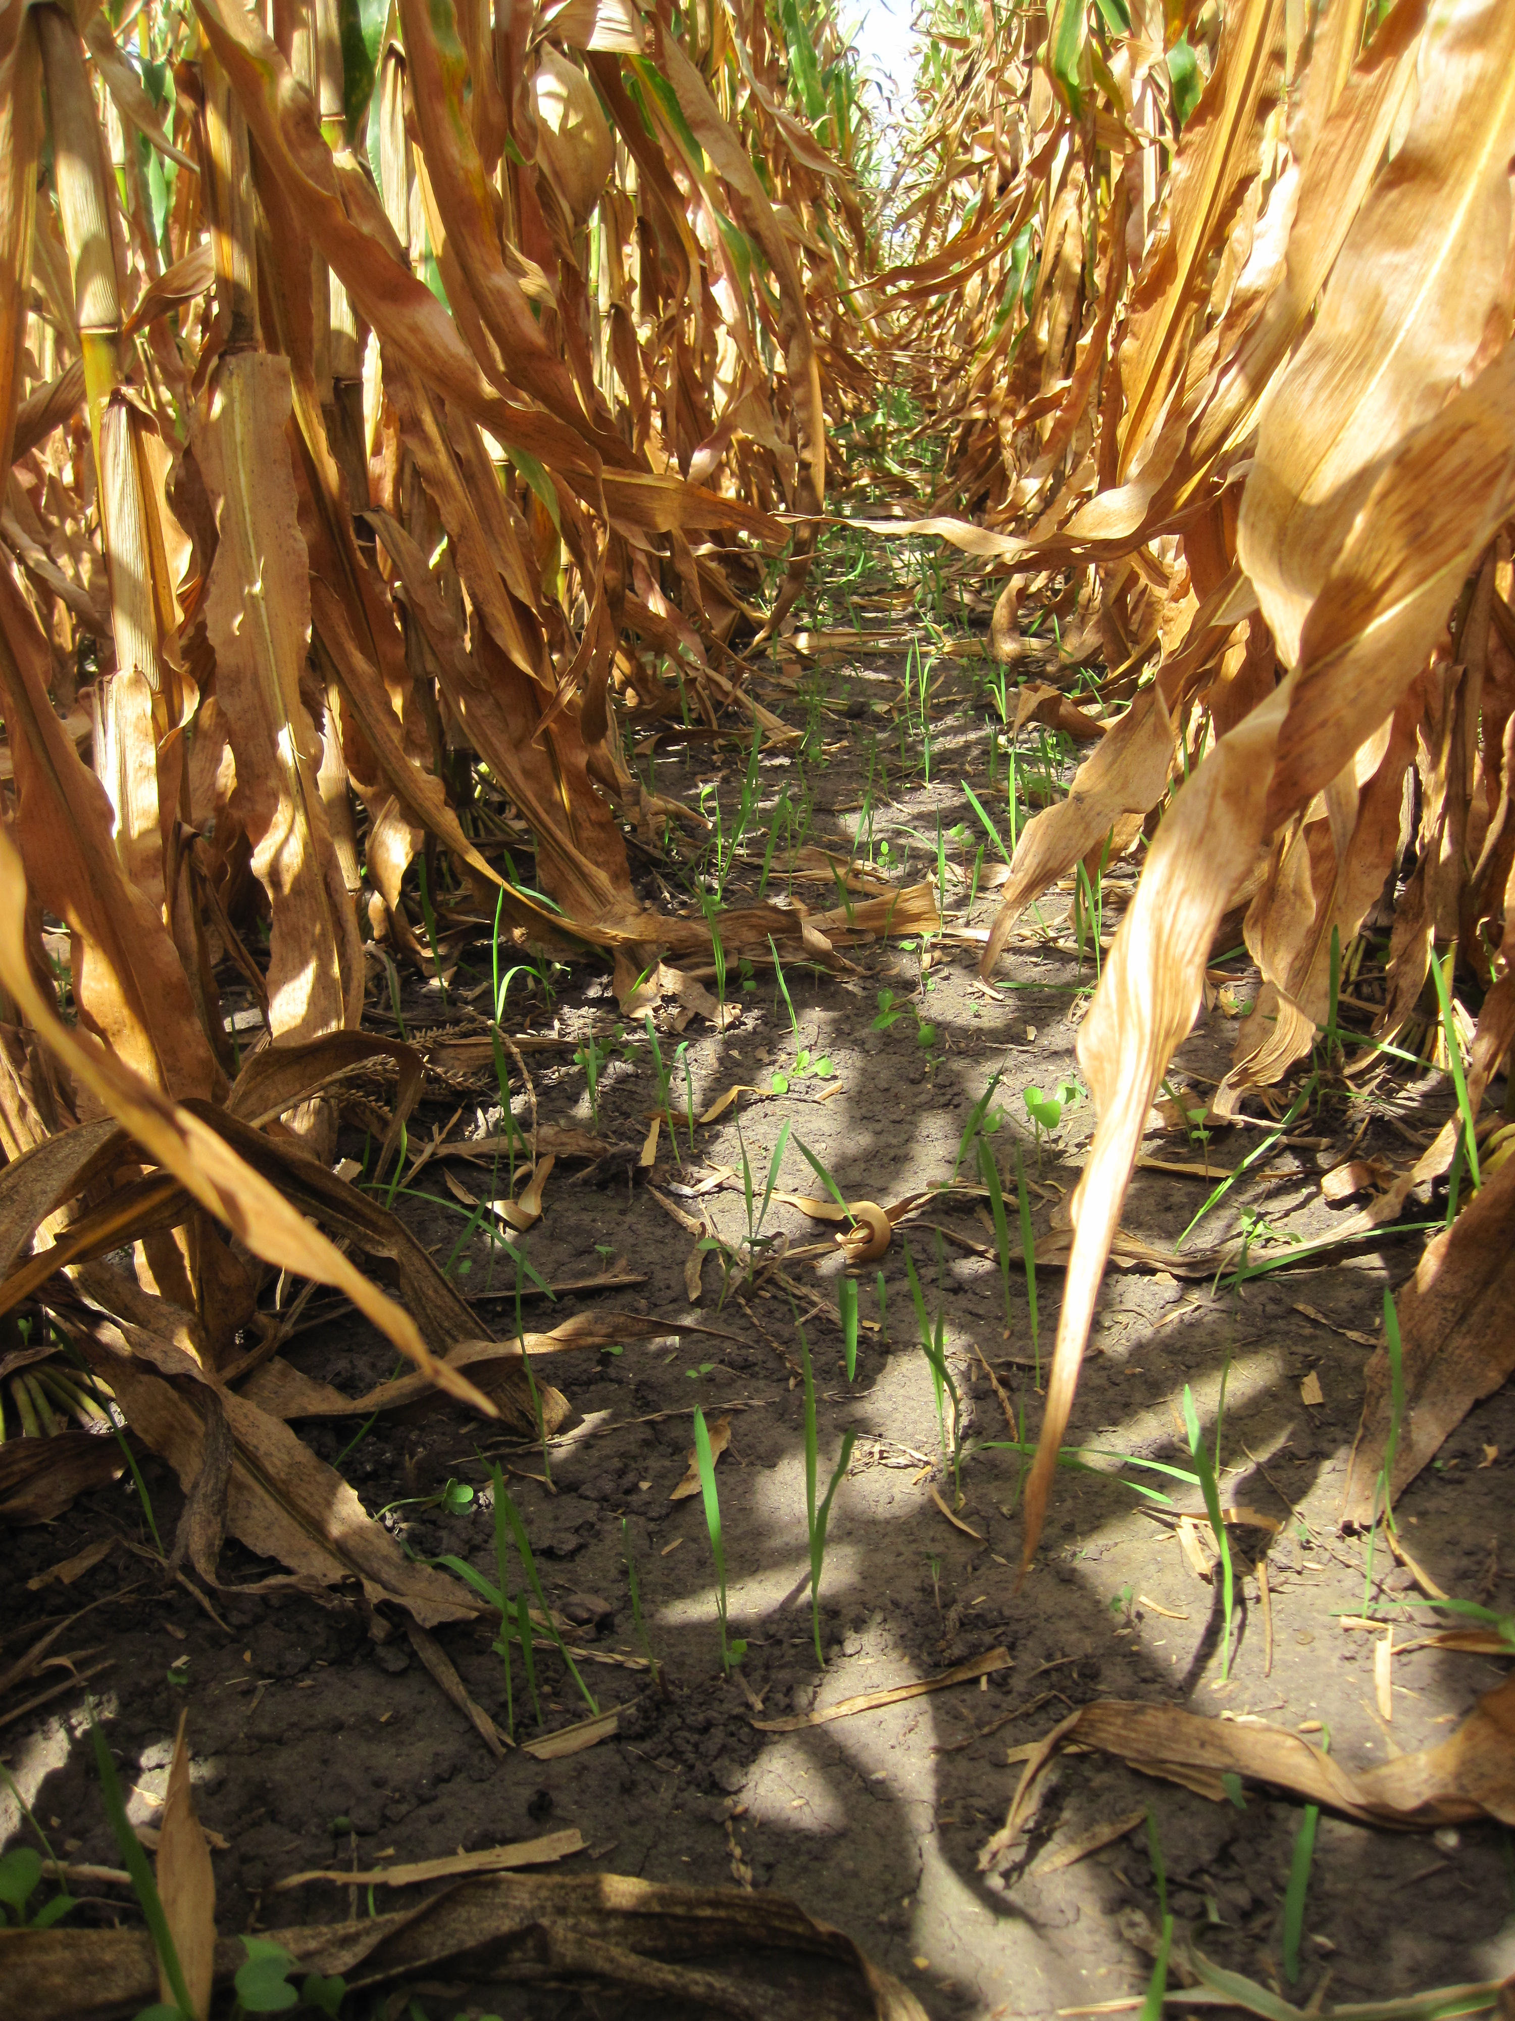
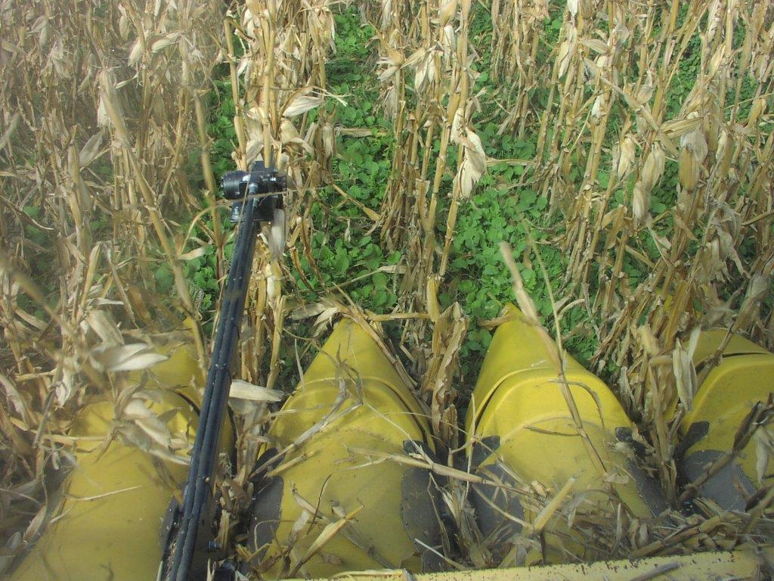
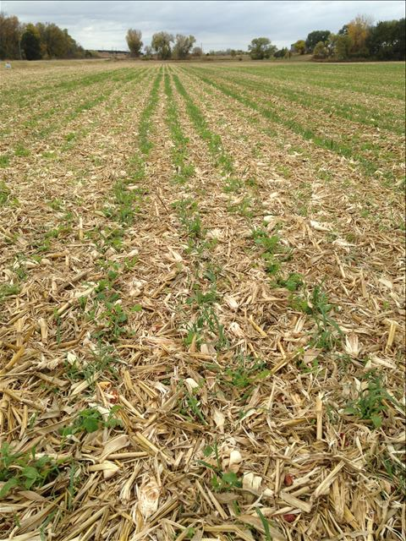
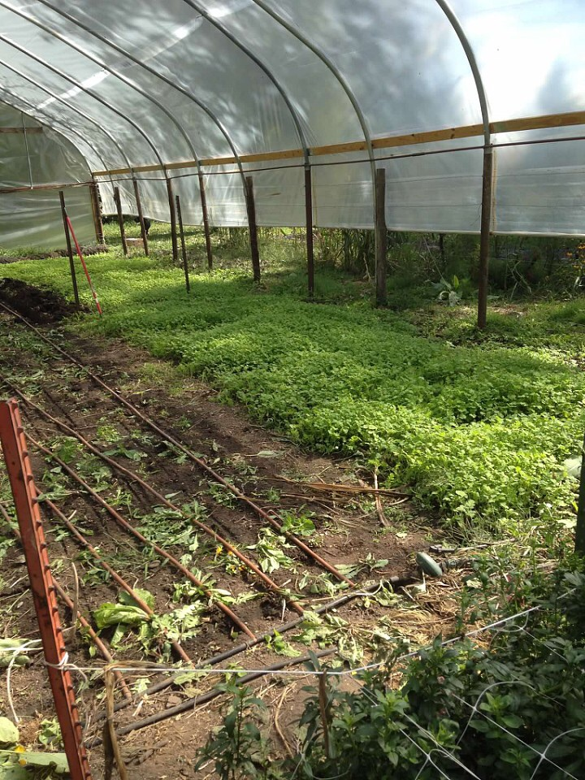
After Wheat for Weed Suppression
After Silage for Grazing
During Fallow Periods
Where do we start?
The why, when, who and how of Cover Crops are many and diverse.
Erosion control, supplemental grazing, weed suppression & compaction
Broadcast into
standing corn
Broadcast into Popcorn
Supplemental Grazing
Soil Health Management
in a hoop house

Slide 26
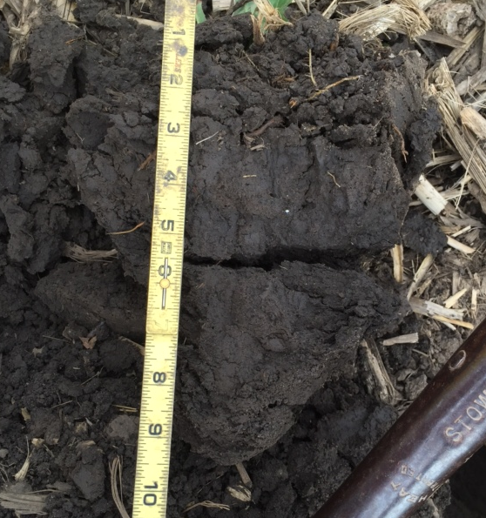
No matter what the reason, building Soil Structure will result in Improved Soil Function!
USDA/NRCS Resource Concern Related Objectives:
Reduce erosion / Seedbed Prep for grass seeding/Supplemental Feed/Forage
Increase soil organic matter content
Capture and recycle or redistribute nutrients
Biological nitrogen fixation
Increase biodiversity/Attract Beneficial Insects
Pest/weed suppression
Manage soil moisture
Minimize and reduce soil compaction

Slide 27
Nebraska NRCS Soil Health Initiative
Partnerships remain our central focus.
Continue to geographically distribute key outreach and educational resources.
Example: Fund and monitor a network of Demonstration Farms across the state.
The Goals of the EQIP Demonstration Farms
Provide a local source of information to answer common questions
Validate Soil Health Management Systems locally via case studies and field days.
Focus on outreach, education, training and partnership opportunities

Slide 28
Demonstration Farms – On Farm Research
A 5 year, field scale, comparison of two Cover Crop Adaptive Management Activities
A system comparison throughout an 5 year expanded crop rotation
Randomized and Replicated Plots
Soil Health Assessments, Soil Lab Analysis and Economic Evaluations
Opportunity to include partners, including UNL Extension & NE On Farm Research Network.
NDRE Source: NE ON FARM RESEARCH

Slide 29
17 In Field Projects – 21 comparisons
Cover Crop Vs No Cover Crop (5)
Cover crop Mix comparisons (4)
Grazed Vs Not Grazed (3)
Drilled Vs Broadcast (2)
High Carbon Cover Crop vs Low Carbon Cover Crop (2)
Nitrogen Study, When and How Much from the Cover Crop(1)
Early Termination vs Late Termination (1)
Frost Terminated Cover Crop vs Winter Hardy Cover Crop (1)
Companion Cover Crop vs Dormant Seeded Cover Crop (1)
Monoculture Cover Crop vs Multispecies Cover Crop (1)

Slide 30
Highlighting a study today in Nemaha Co.

Slide 31
2018 Corn Following Winter Terminated Cover Crop vs Winter Hardy Cover Crop Nemaha County – Daryl Obermeyer – in Partnership with the University of Nebraska – Lincoln, Field 1C On Farm Research Network
Judson Silt Loam 0-2% slope, Judson Silt Loam 2-6% slopes
Planting Date: 4/17/18
Harvest Date: 9/14/18
Cover Crop planted after harvest
Row Spacing: 30”
Hybrid: Pioneer 0363AM
Reps: 7
Previous Crop: Wheat
Tillage: No-Till
Herbicides: Pre: 3 qt/ac FulTime® NXT, 16 oz/ac 6# 2,4-D, and 16 oz/ac Buccaneer 5 Extra® on 4/4/18
Seed Treatment: PONCHO®/VOTiVO®
Foliar Insecticides: 3.84 oz/ac Lambda-Cy 1EC aerial applied on 7/7/18; 3.84 oz/ac Lambda-Cy 1 EC aerial applied on 7/26/18
Foliar Fungicides: 10.5 oz/ac Azoxyprop Xtra aerial applied on 7/7/18; 10.5 oz/ac Azoxyprop Xtra aerial applied on 7/26/18
Fertilizer: 1 gal/ac Kugler KQ-KRN™ (28% N) aerial applied on 7/7/18, and 1 gal/ac Kugler KS2075 (20% N, 7.5% P, 5% S) aerial applied on 7/26/18
Irrigation: None, Note: Drought conditions prevailed in August and September in SE Nebraska
1A
1B
1C
2

Slide 32
2018 Corn Following Winter Terminated Cover Crop vs Winter Hardy Cover Crop Nemaha County – Daryl Obermeyer – in Partnership with the University of Nebraska – Lincoln,
On Farm Research Network
Field 1C | ----------------------------2017 Soybean------------------------ |  |  |  |  | -------------------------------2018 Corn----------------------------
Cover Crop Treatment | Stand Count (plants/ac) | Test Weight | Moisture (%) | Yield† (bu/ac) | Marginal Net Return‡ ($/ac) | Stand Count (plants/ac) | Test Weight | Moisture (%) | Yield† (bu/ac) | Marginal Net Return‡ ($/ac)
Winter Terminated | 102,178 A* | 56 A | 10.6 A | 62 A | 518.84 A | 29,710 A* | 56 A | 20.7 A | 243 A | 759.43 A
Winter Hardy | 102,178 A | 56 A | 10.6 A | 61 A | 516.42 A | 29,515 A | 56 A | 20.9 A | 240 A | 748.71 A
P-Value | 1 | 0.489 | 1 | 0.735 | 0.735 | 0.677 | 0.226 | 0.516 | 0.281 | 0.283
Summary:
In 2017, there were no differences in soybean yield, moisture, test weight, or harvest stand counts when cover crops were winter terminated or winter hardy. Harvest stand counts were notably lower than the planting population.
In 2018, there were no differences in corn yield, moisture, test weight, harvest stand counts, or net return between the winter terminated or winter hardy cover crop treatment. Corn following winter terminated cover crops stayed green longer.
8-2-2018

Slide 33
2018 Soybeans Following Winter Killed Cover Crop vs Winter Hardy Cover Crop Nemaha County – Daryl Obermeyer – in Partnership with The University of Nebraska – Lincoln, Field 1A Nebraska On Farm Research Network
Soil Type: Judson silt loam 0-2% slope; Judson silt loam 2-6% slopes
Planting Date: 5/7/18
Harvest Date: 9/17/18
Cover crop planted after harvest
Row Spacing (in): 15
Hybrid: Pioneer 24T19R
Reps: 4
Previous Crop: Corn
Tillage: No-Till
Herbicides:6 oz/ac Sonic®, 16 oz/ac generic Dual, 16 oz/ac 2,4-D 6#, 8 oz/ac Absorb 100, and 16 oz/ac Buccaneer 5 Extra® on 4/17/18 Post: 16 oz/ac Shafen Star, 8 oz/ac Clethodim 2EC, 32 oz/ac Buccaneer 5 Extra®, 8 oz/ac Absorb 100, and 4 oz/ac N-Tense on 6/16/18
Foliar Insecticides: 3.84 oz/ac Lambda-Cy 1 EC aerial applied on 7/26/18
Foliar Fungicides: 10.5 oz/ac Azoxyprop Xtra aerial applied on 7/26/18
Fertilizer: 1 gal/ac Kugler KS2075 (20% N, 7.5% P, 5% S) aerial applied on 7/26/18
Irrigation: None – Note: Drought conditions prevailed in Aug. & Sept.
1A
1B
1C
2

Slide 34
Soybeans Following Winter Killed Cover Crop vs Winter Hardy Cover Crop Nemaha County – Daryl Obermeyer – in Partnership with the University of Nebraska – Lincoln, On Farm Research Network
Field 1A | ----------------------------2017 Corn------------------------------ |  |  |  |  | --------------------------2018 Soybeans--------------------------
Cover Crop Treatment | Stand Count (plants/ac) | Test Weight | Moisture (%) | Yield† (bu/ac) | Marginal Net Return‡ ($/ac) | Stand Count (plants/ac) | Test Weight | Moisture (%) | Yield† (bu/ac) | Marginal Net Return‡ ($/ac)
Winter Terminated | 30,355 A* | 54 A | 18.0 B | 183 A | 546.97 A | 120,744 A* | 56 B | 11.3 A | 65 A | 452.80 A
Winter Hardy | 30,023 A | 52 B | 19.1 A | 168 B | 498.00 B | 120,246 A | 56 A | 11.2 A | 59 B | 410.75 B
P-Value | 0.802 | 0.021 | 0.003 | 0.0003 | 0.0003 | 0.872 | 0.096 | 0.200 | 0.002 | 0.002
In 2018, soybeans planted after winter terminated cover crops had a higher yield, lower test weight, and higher net return than the winter hardy cover crops. There were visible differences between the winter terminated and winter hardy cover crops, with the winter terminated having a darker green appearance longer.

Slide 37
How soon do we need to improve Nebraska’s Soil Health?

Slide 38
In accordance with Federal civil rights law and U.S. Department of Agriculture (USDA) civil rights regulations and policies, the USDA, its Agencies, offices, and employees, and institutions participating in or administering USDA programs are prohibited from discriminating based on race, color, national origin, religion, sex, gender identity (including gender expression), sexual orientation, disability, age, marital status, family/parental status, income derived from a public assistance program, political beliefs, or reprisal or retaliation for prior civil rights activity, in any program or activity conducted or funded by USDA (not all bases apply to all programs). Remedies and complaint filing deadlines vary by program or incident.
Persons with disabilities who require alternative means of communication for program information (e.g., Braille, large print, audiotape, American Sign Language, etc.) should contact the responsible Agency or USDA’s TARGET Center at (202) 720-2600 (voice and TTY) or contact USDA through the Federal Relay Service at (800) 877-8339. Additionally, program information may be made available in languages other than English.
To file a program discrimination complaint, complete the USDA Program Discrimination Complaint Form, AD-3027, found online at How to File a Program Discrimination Complaint and at any USDA office or write a letter addressed to USDA and provide in the letter all of the information requested in the form. To request a copy of the complaint form, call
(866) 632-9992. Submit your completed form or letter to USDA by:
(1) mail: U.S. Department of Agriculture
Office of the Assistant Secretary for Civil Rights
1400 Independence Avenue, SW
Washington, D.C. 20250-9410;
(2) fax: (202) 690-7442; or
(3) email: program.intake@usda.gov.
USDA is an equal opportunity provider, employer, and lender.

Slide 39
Contact Info
Aaron Hird, State Soil Health Specialist, Nebraska - USDA/NRCS
100 Centennial Mall North, Room 152
1-402-437-4053
Aaron.Hird@usda.gov
www.nrcs.usda.gov/clientgateway
http://www.nrcs.usda.gov/wps/portal/nrcs/site/ne/home/

