Slide 1
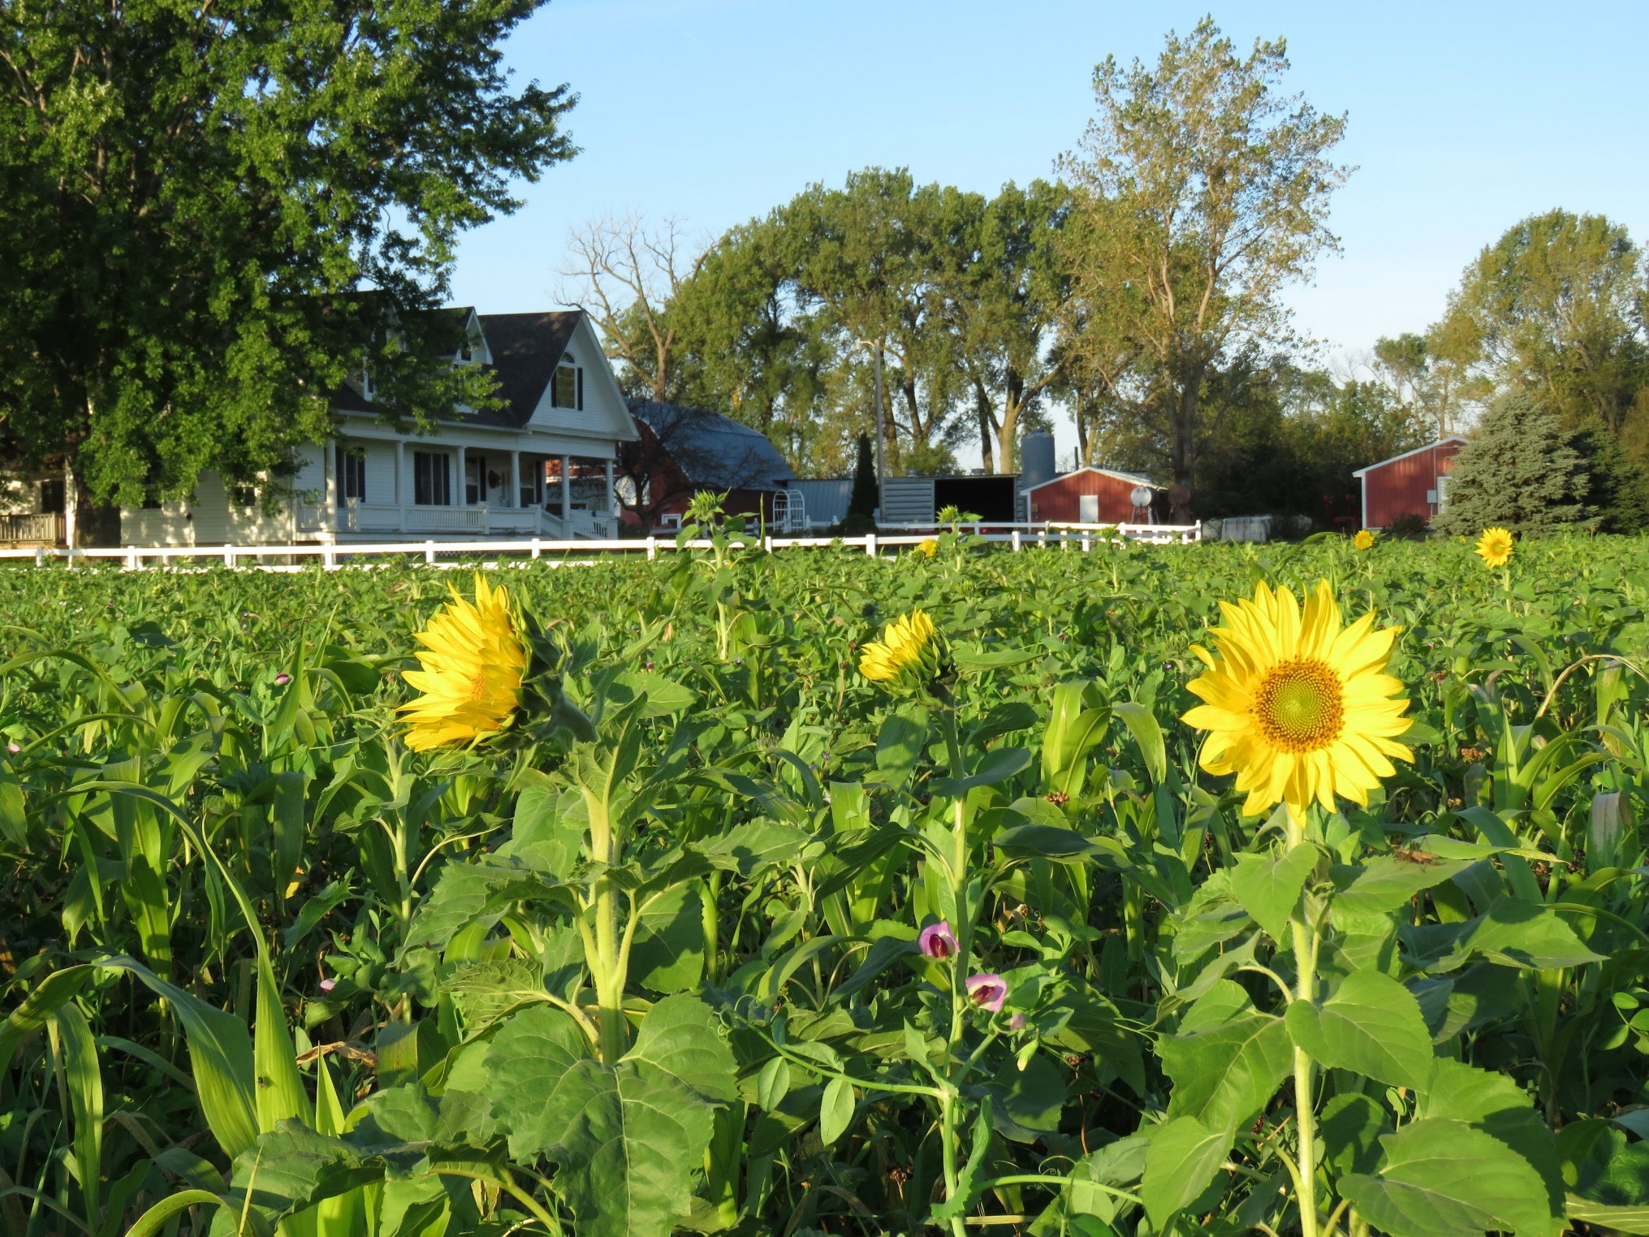
Soil Health Economics
Community based Regenerative Agriculture for the Health and Prosperity of Rural And Urban Nebraska

Slide 2
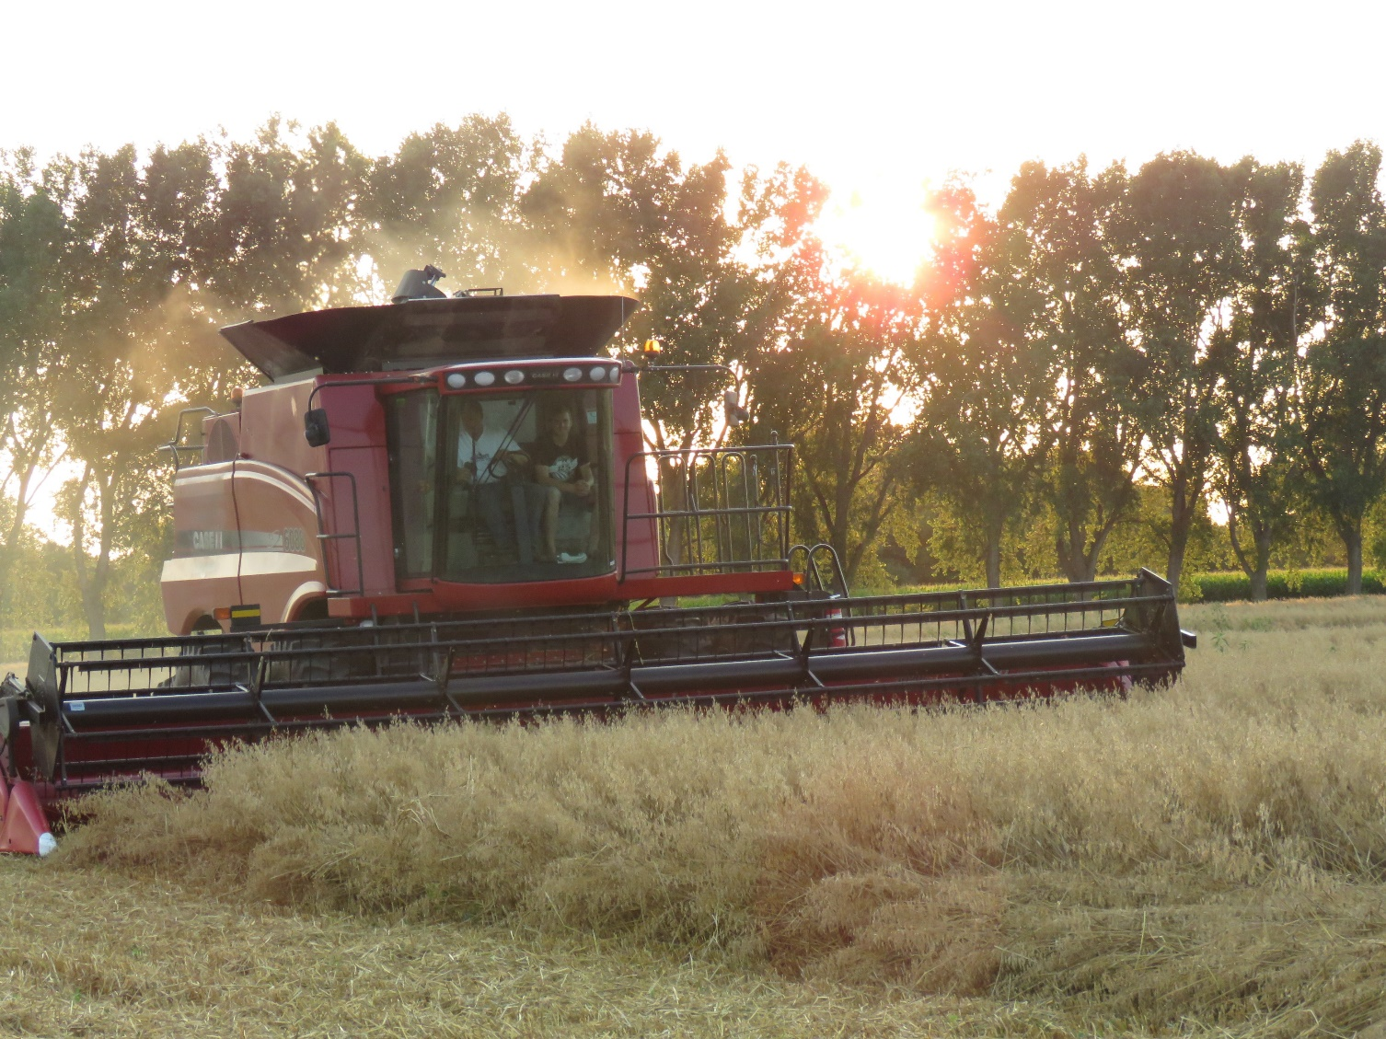
Proving the Economics of Soil Health
For the Farmer For the non-Farmer
This Photo by Unknown Author is licensed under CC BY

Slide 3
Proving Economics of Soil Health for Farmers
-- Total System Approach
Economics of the Farm as a whole unit, not by individual Crops
-- Data and Modeling proving Soil Health
What combination of practices rise to the top ( tillage, cover crops, cash crops, fertility, weed control, irrigation etc.)
Research Hubs across the State
-- Local Peer groups for Education
led by local leaders in Soil Health and assisted by NRCS, NRD, UNL, and Ag Business
Challenge producers to completely change their way of thinking
-- Technical and Financial assistance for Soil Health Beginners
Collaboration of NRCS, NRD, UNL, and Ag Business
-- Market Success in Soil Health to Farmers
Educate Farmers on long term success possibilities (Regenerated Soils)

Slide 4
Economics of Soil Health for Non-Farmers
--Cleaner Surface and Ground Water
Treating water for drinking is very expensive.
Less nutrient runoff cleans up stream
--Flood Control
Improved water infiltration on the land scape reduces flood control costs.
-- Educate Absentee Land Owners and Land Managers
-- Market the Benefits to the Public
Concentrate on problem areas and work hard for improvement
Healthy Soil, Healthy Food, Healthy Environment, Healthy Life.

Slide 5
Other thoughts for Proving Economics of Soil Health Practices
Community based research fields and plots
led by local Soil Health Leaders (Possibly organized and led by a State Soil Health Coalition)
-- UNL, Education for Farmers in Soil Health Practices
Help with setting up plots and data management for economic comparisons
-- NRD’s, Organizational and Technical assistance .
Have research plots done in areas where the NRD’s are already working on Soil
and Water quality issues and tie the work together.
-- NRCS Funding and Technical assistance for beginners implementing the new Soil
Health Practices.
-- Collaboration of all entities to show case the successes in Soil Health improvement

Slide 6
Using Data to Prove Soil Health Economics
The following three slides are examples of economic data collected on land where Soil Health Practices have been used for more than 5 years and compared to local UNL crop budget data.

Slide 7
2019 UNL crop budgets compared to my yields and costs
(using same land and machinery costs and adding in cover crop cost)
UNL Crop Budget
Low cost Average My Cost
Irrigated Corn 2.91/bu 3.32/bu 2.79/bu
Dryland Corn Eastern Ne 3.27/bu 3.53/bu 2.83/bu
Irrigated Soybeans Eastern Ne 7.45/bu 8.26/bu 6.52/bu
Dryland Soybeans Statewide 7.48/bu 8.02/bu 6.38/bu
Wheat 5.04/bu
Oats Northeast Ne 2.90/bu
Do cover crops pay?

Slide 8
Input Costs
UNL Irrigated Corn | My Irrigated Corn| UNL Soybeans | My Soybeans
Field Operations 155 102 103 84
Chemical 60 19 55 25
Seed 114 81 66 24
Fertilizer 103 60 0 10
____ ____ ____ ____
Totals 432 262 224 143

Slide 9
Soil Biology & Organic Matter are
our Cash Cows
We need to feed them!
-- Cover Crops
-- More Carbon in the Rotation (Wheat?)
-- Keep the ground covered
The straw from 75bu Wheat contains
50#N 5#p 100#K 3000# Carbon (Duane Beck)
The Payoff
-- Less inputs -- Less erosion (almost none with No-Till)
-- As good or better yields -- More water holding capacity
-- Better water infiltration -- Better water quality

