Slide 1
Ecosystem Services
Subcommittee of the Nebraska Healthy Soils Task Force
November 19, 2019

Slide 2
Subcommittee Members
1
Steve Tucker
5
Clay Govier
HSTF member and subcomittee co-chair
Farmer, ex officio member
2
Ron Bolze
6
Aldyen Donnelly
HSTF member
Nori Carbon Removal, ex officio member
3
Hannah Birge
7
Andrea Basche
HSTF member and subcommittee chair
UNL Dept. Ag & Hort, ex officio member
4
Alex Brechbill
Office of Sen. Gragert, ex officio member

Slide 3
Meeting #1
Proposed Topics

Slide 4
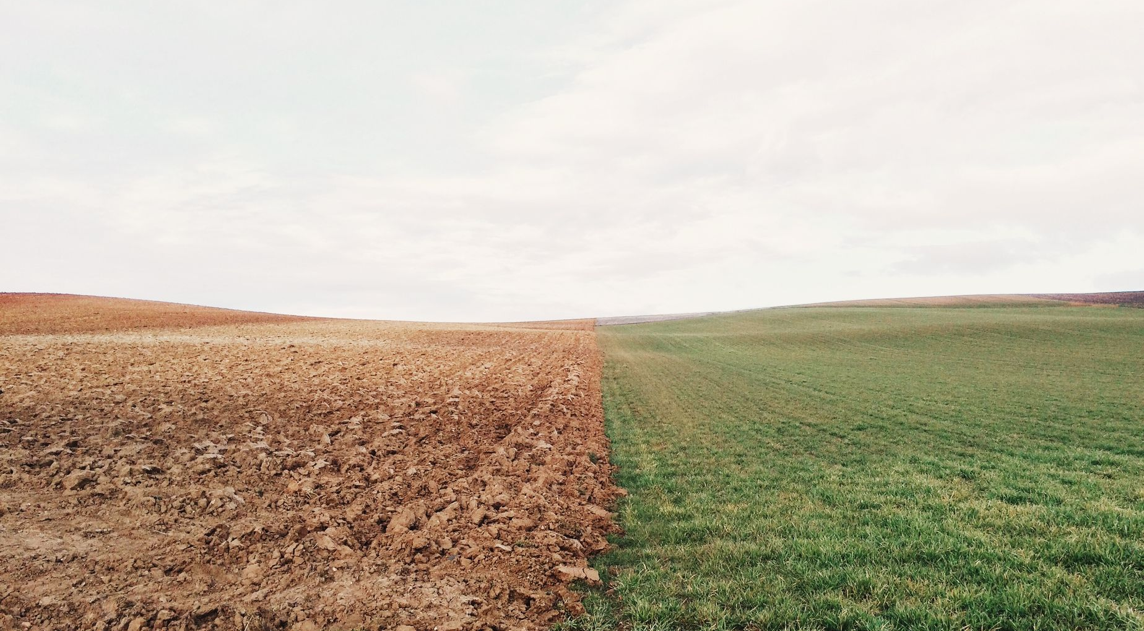
One Health
Ecosystem Service Markets
Ecosystem Services Inventory

Slide 5
Meeting #2
Ecosystem Services Markets

Slide 6
Carbon
Nutrients
Water

Slide 7
Outcomes and Deliverables
1
Education and preparation for farmers seeking to access the marketplace
2
Guardrails for policymakers to encourage a a viable market that benefits farmers

Slide 8
Mission statement?

Slide 9
Thank you!
Hannah, Steve, and Ron

